Slide 1
Computational Operations & Units
Boxi Wu / Xiaofei He
Zhejiang University

Slide 2
Overview
Addition
Subtraction
Arithmetic logic unit (ALU)
Multiplication
Division
Floating number operations

Slide 3
Overview
Addition
Subtraction
Arithmetic logic unit (ALU)
Multiplication
Division
Floating number operations

Slide 4
Iterative Combinational Circuits
Arithmetic functions
  Operate on binary vectors
  Use the same subfunction in each bit position
Can design functional block for subfunction and repeat to obtain functional block for overall function
Cell - subfunction block
Iterative array - a array of interconnected cells
An iterative array can be in a single dimension (1D) or multiple dimensions
Notes:
迭代式组合电路只在计算机中有，一般的逻辑电路不会用到，
在计算机中经常用到，因为是对位向量进行操作，而不是对一位。对多位进行操作，每一位的操作都是相似的，所以一般先设计一位，然后进行迭代
迭代不是简单地复制就可以了，成本高，效率低，也要进行优化。
迭代阵列可以是一维的，也可以是多维的

Slide 5
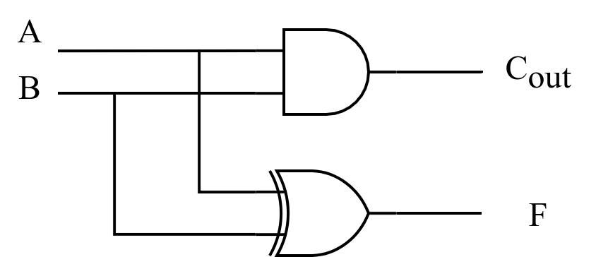
1-bit adder: Half-Adder
A 2-input, 1-bit width binary adder that performs the following computations:
A half adder adds two bits to produce a two-bit sum
The sum is expressed as a sum bit , F and a carry bit, C
The half adder can be specified as a truth table for F and C ⇒
A
0
0
1
1
+ B
+ 0
+ 1
+ 0
+ 1
C F
0 0
0 1
0 1
1 0
A
B
F
C
0
0
0
0
0
1
1
0
1
0
1
0
1
1
0
1
Notes:
F= A XOR B
Cout = AB

Slide 6
1-bit adder: Full Adder
A full adder is similar to a half adder, but includes a carry-in bit from lower stages.
Like the half-adder, it computes a sum bit F and a carry bit C_{in}
  For a carry-in (C_{in}) of 0, it is the same as the half-adder:
  For a carry-in
  (C_{in}) of 1:
Cin
0
0
0
0
A
0
0
1
1
+ B
+ 0
+ 1
+ 0
+ 1
Cout F
0
0
0 1
0 1
1 0
Cin
1
1
1
1
A
0
0
1
1
+ B
+ 0
+ 1
+ 0
+ 1
Cout F
0 1
1 0
1 0
1
1
Notes:
F = A XOR B XOR C_{in}
C_{out} = AB + AC_{in} + Bc_{in}

Slide 7
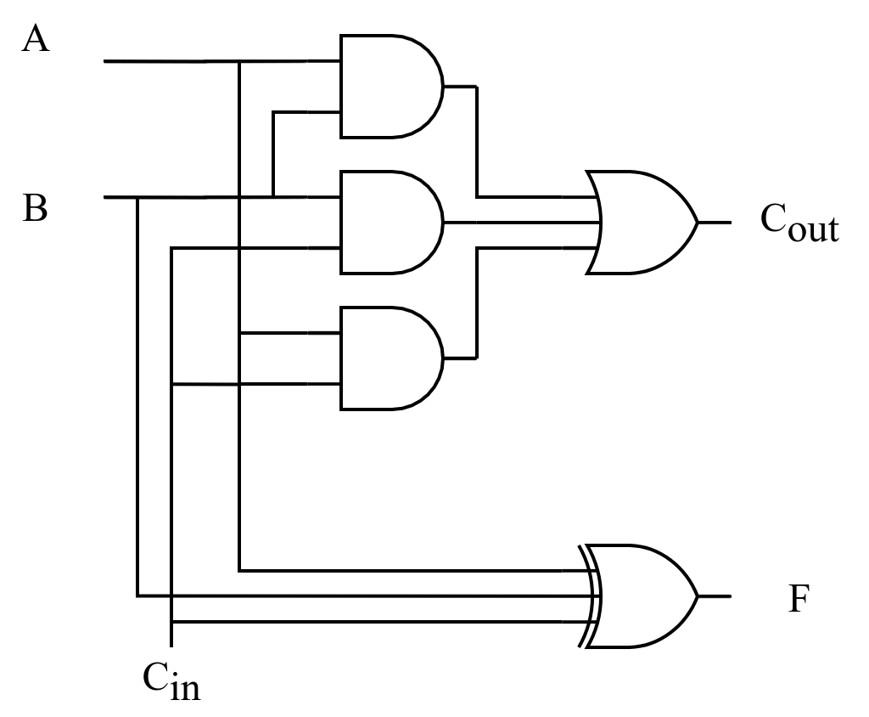
Classic Designs: Full Adder (cont’d)
Input |  |  | Output
A | B | C_{in} | F | C_{out}
0 | 0 | 0 | 0 | 0
0 | 0 | 1 | 1 | 0
0 | 1 | 0 | 1 | 0
0 | 1 | 1 | 0 | 1
1 | 0 | 0 | 1 | 0
1 | 0 | 1 | 0 | 1
1 | 1 | 0 | 0 | 1
1 | 1 | 1 | 1 | 1
Notes:
F = A XOR B XOR C_{in} = (A XOR B) XOR C
C_{out} = AB + AC_{in} + Bc_{in} = AB + C_{in}(A + B)
2 HA + OR -> FA

Slide 8
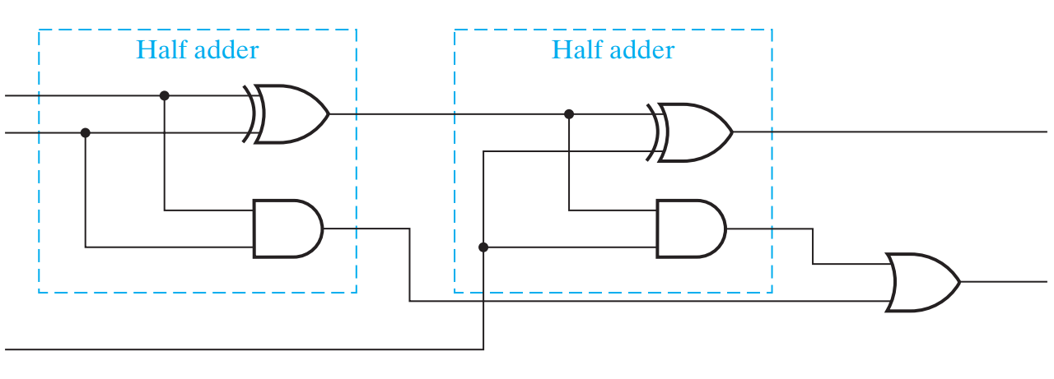
Classic Designs: Full Adder (cont’d)
A
B
F
Cout
Cin
Notes:
F = A XOR B XOR C_{in} = (A XOR B) XOR C
C_{out} = AB + AC_{in} + Bc_{in} = AB + C_{in}(A + B)
2 HA + OR -> FA

Slide 9
Multibit Carry Propagate Adders (CPA)
Types of CPA
  Ripple-carry (slow)
  Carry Skip
  Carry Select
  Carry-lookahead (fast)
  Prefix (fast)
Faster adders require more hardware
Notes:
CRA: 行波进位加法器（串行）
CLA：先行进位加法器（并行）
Prefix：前缀加法器
几乎所有的算术运算都要用到ALU，ALU的核心是加法器，所以加法器的速度是提高运算速度的关键。
串行有依赖关系，并行消除依赖关系。

Slide 10
Ripple-Carry Adder (RCA)
Chain 1-bit adders together
Carry ripples through entire chain
Disadvantage: slow

Slide 11
Ripple-Carry Adder Delay
t_{ripple} = Nt_{FA}
t_{FA}: delay of a 1-bit full adder

Slide 12
Carry Lookahead Adder
P
=
A
⊕
B
G
=
A
B
i
i
i
i
i
i
S
=
P
⊕
C
C
=
G
+
P
C
i
i
i
i
+
1
i
i
i
Ai
Bi
For a given i-bit binary adder,
  If A_{i} = B_{i} = “1” and whatever C_{i} is, we have carry out as 1, that is C_{i+1} = 1
  If the output of half adder is 1 and we have carry in as 1, we have carry out as 1，that is C_{i+1} = 1
These two conditions of setting carry out as 1 is called generate (G_{i}) and propagate (P_{i}).
Gi
Pi
Ci
Ci+1
Si
Notes:
C1=G0+P0C0
C2=G1+P1C1=G1+P1G0+P1P0C0

Slide 13
Carry Lookahead Development
C_{i+1} = G_{i} + P_{i}C_{i} can be removed from the cells and used to derive a set of carry equations spanning multiple cells.
Beginning at the cell 0 with carry in C₀:
C1 = G0 + P0 C0
C2 = G1 + P1 C1 = G1 + P1(G0 + P0 C0)
= G1 + P1G0 + P1P0 C0
C3 = G2 + P2 C2 = G2 + P2(G1 + P1G0 + P1P0 C0)
= G2 + P2G1 + P2P1G0 + P2P1P0 C0
C4 = G3 + P3 C3
= G3 + P3G2 + P3P2G1+ P3P2P1G0 + P3P2P1P0 C0
Notes:
公式看着复杂，但是只有两级门，延迟大大减小。坏处是成本大，

Slide 14
4-Bit CLA
Partial full adder
Carry Look-ahead Adder

Slide 15
Group Carry Lookahead Logic
Figure in the previous slide shows the implementation of these equations for four bits. This could be extended to more than four bits; in practice, due to limited gate fan-in, such extension is not feasible.
C₄= G₃ + P₃G₂ + P₃P₂G₁+ P₃P₂P₁G₀ + P₃P₂P₁P₀ C₀
Instead, the concept is extended another level by considering group generate (G₀₋₃) and group propagate (P₀₋₃) functions:
Using these two equations:
Thus, it is possible to have four 4-bit adders use one of the same carry lookahead circuit to speed up 16-bit addition
G
0
∼
3
=
G
3
+
P
3
G
2
+
P
3
P
2
G
1
+
P
3
P
2
P
1
P
0
G
0
P
0
∼
3
=
P
3
P
2
P
1
P
0
C
=
G
+
P
C
4
0
∼
3
0
∼
3
0

Slide 16
Group Carry Lookahead Logic (Cont.)
C₄ = G₃ + P₃G₂ + P₃P₂G₁ + P₃P₂P₁G₀ + P₃P₂P₁P₀C₀= G_{0~3}+ P_{0~3}C₀
C₈ = G₇ + P₇G₆ + P₇P₆G₅ + P₇P₆P₅G₄ + P₇P₆P₅P₄C₄= G_{4~7}+ P_{4~7}C₄
C₁₂ =G₁₁+P₁₁G₁₀+P₁₁P₁₀G₉+P₁₁P₁₀P₉G₈+ P₁₁P₁₀P₉P₈C₈= G_{8~11}+ P_{8~11}C₈
C₁₆=G₁₅+P₁₅G₁₄+P₁₅P₁₄G₁₃+P₁₅P₁₄P₁₃G₁₂+P₁₅P₁₄P₁₃P₁₂C₁₂= G_{12~15}+ P_{12~15}C₁₂

Slide 17
Group Carry Lookahead Logic (Cont.)
C₄ = G_{0~3}+ P_{0~3}C₀
C₈ = G_{4~7}+ P_{4~7}C₄
C₁₂ = G_{8~11}+ P_{8~11}C₈
C₁₆ = G_{12~15}+ P_{12~15}C₁₂
C1 = G0 + P0 C0
C2 = G1 + P1 C1
C3 = G2 + P2 C2
C4 = G3 + P3 C3

Slide 18
Carry Lookahead Example
Specifications:
  16-bit CLA
  Delays:
    NOT = 1
    XOR = Isolated AND = 3
    AND-OR = 2
Longest Delays:
  Ripple carry adder* = 3 + 15 ⋅ 2 + 3 = 36
  CLA = 3 + 3 ⋅ 2 + 3 = 12
3
3
CLA
CLA
CLA
CLA
2
2
CLA
2

Slide 19
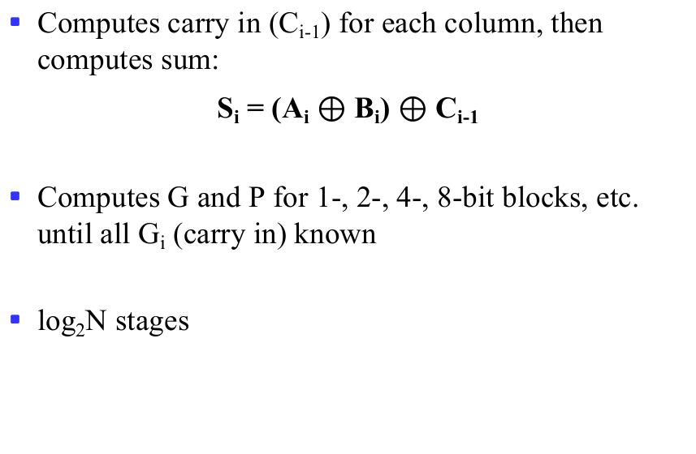
Prefix Adder
Computes carry in (C_{i-1}) for each column, then computes sum:
S_{i} = (A_{i} $⊕$ B_{i}) $⊕$ C_{i-1}
Computes G and P for 1-, 2-, 4-, 8-bit blocks, etc. until all G_{i} (carry in) known
log₂N stages
Notes:
为进一步提高运算速度，可以采用组内和组间都并行的两级先行进位方式。

Slide 20
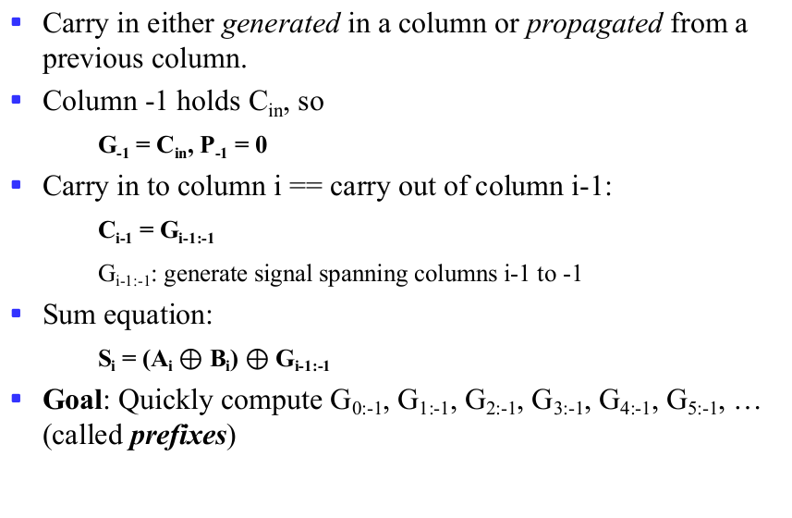
Prefix Adder (cont’d)
Carry in either generated in a column or propagated from a previous column.
Column -1 holds C_{in}, so
G₋₁ = C_{in}, P₋₁ = 0
Carry in to column i == carry out of column i-1:
C_{i-1} = G_{i-1:-1}
G_{i-1:-1}: generate signal spanning columns i-1 to -1
Sum equation:
S_{i} = (A_{i} $⊕$ B_{i}) $⊕$ G_{i-1:-1}
Goal: Quickly compute G_{0:-1}, G_{1:-1}, G_{2:-1}, G_{3:-1}, G_{4:-1}, G_{5:-1}, … (called prefixes)

Slide 21
Prefix Adder (cont’d)
Generate and propagate signals for a block spanning bits i:j:
G_{i:j} = G_{i:k} + P_{i:k} G_{k-1:j}
P_{i:j} = P_{i:k}P_{k-1:j}
In words:
  Generate: block i:j will generate a carry if:
    upper part (i:k) generates a carry or
    upper part propagates a carry generated in lower part (k-1:j)
  Propagate: block i:j will propagate a carry if both the upper and lower parts propagate the carry

Slide 22
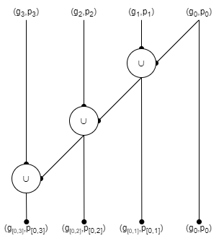
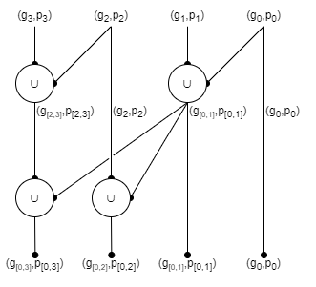
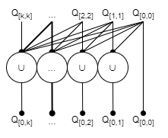

Slide 23
Prefix Adder Schematic

Slide 24
Prefix Adder Delay
t_{PA} = t_{pg} + log₂N(t_{pg_prefix}) + t_{XOR}
t_{pg}: delay to produce P_{i}G_{i} (AND or OR gate)
t_{pg_prefix}: delay of black prefix cell (AND-OR gate)

Slide 25
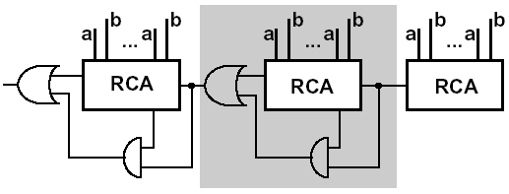
Carry skip adder
Accelerating the carry by skipping the interior blocks
Optimal speed with no-equal distribution of block length
Notes:
RCA：ripple carry adder
进位跳跃加法器是串行进位加法器的改进结构。它将整个加法器分为几组，如果某组的所有进位传播信号都为“1”，则将该组的进位输入直接传送到输出，不需要进行进位运算

Slide 26
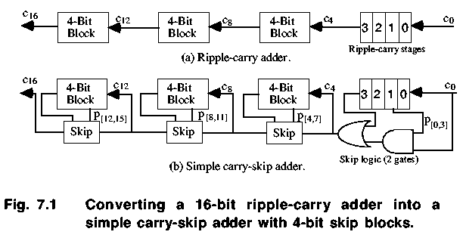
Carry skip adder
Notes:
Carry propagate pi signals may be used within a group of bits to accelerate the carry propagation. If all the pi signals within the group are pi=1, carry bypasses the entire group as shown in the figure.
In the variable block carry skip adder design, a 32-bit adder is divided to 4 groups with bit widths taken as 4, 6, 18, 4

Slide 27
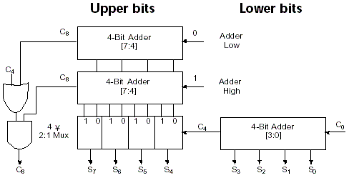
Carry select adder (CSA)
Notes:
Calculate two results and use the correct one, this technique increases the area utilization but addition operation fastens
延迟：一个8位超前进位加法器+2-to-1mux点延迟

Slide 28
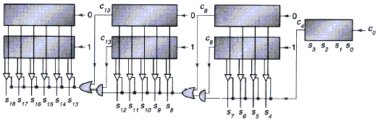
Carry select adder
Carry selection by nibbles
Notes:
分成3组，4组比分成2组更快，成本更高。

Slide 29
Overview
Addition
Subtraction
Arithmetic logic unit (ALU)
Multiplication
Division
Floating number operations

Slide 30
Unsigned Subtraction
For n-digit, unsigned numbers M and N, find M − N in base 2:
  Add the 2's complement of the subtrahend N to the minuend M:
  M + (2^{n} − N) = M − N + 2^{n}
  If M > N, the sum produces end carry r^{n} which is discarded; from above, M − N remains.
  If M < N, the sum does not produce an end carry and, from above, is equal to 2^{n} − ( N − M ), the 2's complement of ( N − M ).
  To obtain the result − (N – M) , take the 2's complement of the sum and place a − to its left.
Notes:
…

Slide 31
Unsigned 2’s Complement Subtraction Example 1
Find 01010100₂ – 01000011₂
01010100 01010100
– 01000011 + 10111101
00010001
The carry of 1 indicates that no correction of the result is required.
1
2’s comp
Notes:
…

Slide 32
Unsigned 2’s Complement Subtraction Example 2
Find 01000011₂ – 01010100₂
01000011 01000011
– 01010100 + 10101100
11101111
00010001
The carry of 0 indicates that a correction of the result is required.
Result = – (00010001)
0
2’s comp
2’s comp
Notes:
…

Slide 33
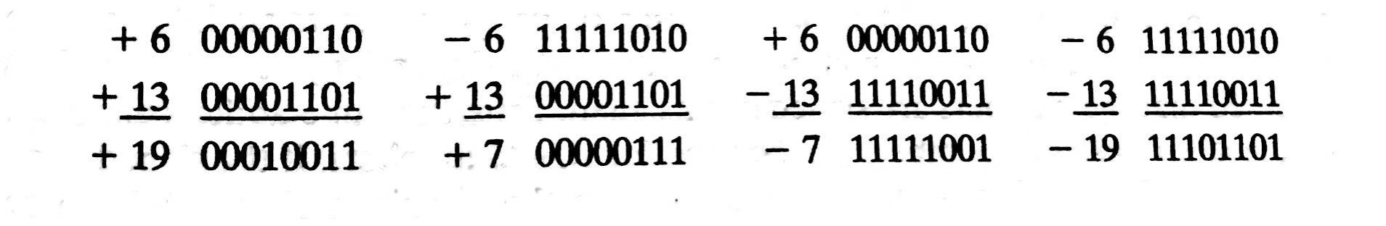
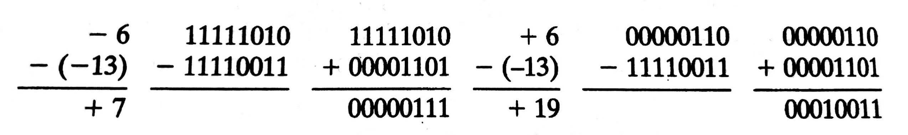
Signed 2’s Complement Arithmetic Examples
Signed binary addition using 2s complement
Signed binary subtraction using 2s complement

Slide 34
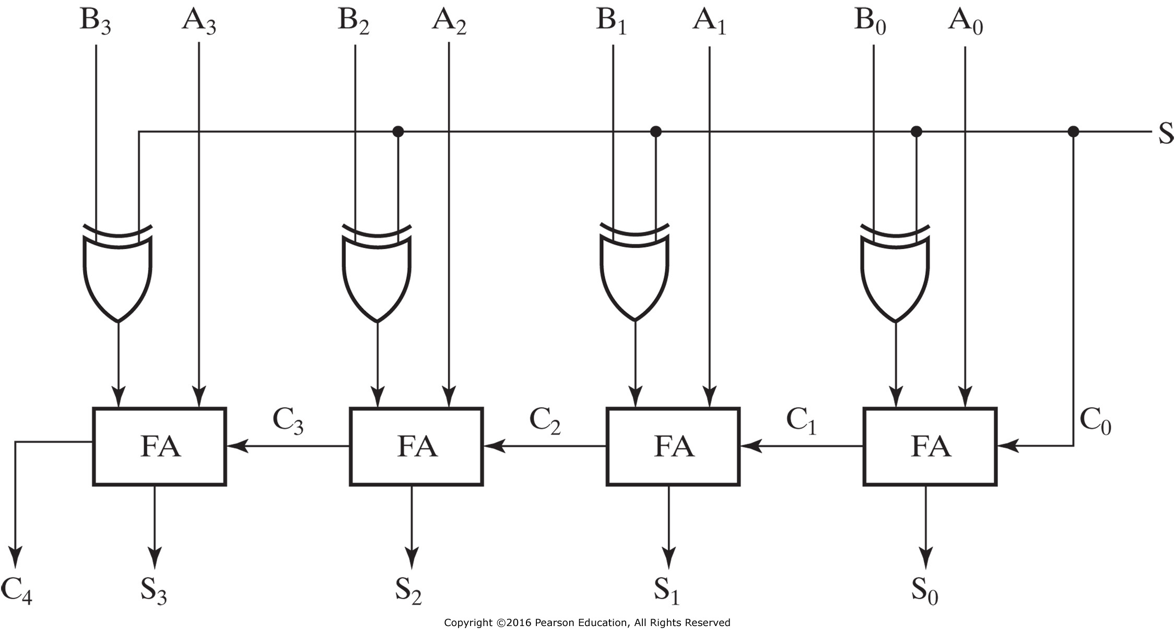
4-Bit Binary Adder-Subtractors
When S=0: Addition (A+B)
When S=1: Subtraction (A+2’s complement of B)
Can be used to add/subtract unsigned numbers and signed 2’s complement numbers

Slide 35
Addition/Subtraction
Both can be handled by using 2’s complement representation
Can achieve a unified implementation
  Addition vs. subtraction
  Unsigned vs. signed
Corner cases shall be considered
  Some important flags

Slide 36
Carry & Overflow
Carry is important when…
  Adding or subtracting unsigned integers
  Indicates that the unsigned sum is out of range
  Either < 0 or > maximum unsigned n-bit value
Overflow is important when…
  Adding or subtracting signed integers
  Indicates that the signed sum is out of range
Overflow occurs when?
Notes:
广义来讲，carry可被视为unsigned number的overflow
In unsigned magnitude addition
A carry out of the left-most bit is also an overflow
In unsigned magnitude subtraction
Overflow will occur in subtraction if we must borrow prior to the left-most bit

Slide 37
Signed Overflow
With two’s complement and a 4-bit adder, for example, the largest representable decimal number is +7, and the smallest is -8.
What if you try to compute 4 + 5, or (-4) + (-5)?
We cannot just include the carry out to produce a five-digit result, as for unsigned addition. If we did, (-4) + (-5) would result in +23!
Also, unlike the case with unsigned numbers, the carry out cannot be used to detect overflow, by itself
  In the example on the left, the carry out is 0 but there is overflow.
  Conversely, there are situations where the carry out is 1 but there is no overflow.
0 1 0 0 (+4)
+ 0 1 0 1 (+5)
0 1 0 0 1 (-7)
1 1 0 0 (-4)
+ 1 0 1 1 (-5)
1 0 1 1 1 (+7)

Slide 38
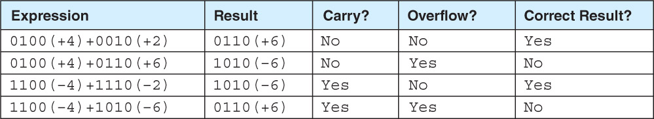
How to Detect Signed Overflow?
The impact of carry and overflow
The easiest way to detect signed overflow is to look at all the sign bits.
Examples of four signed additions
0 1 0 0 (+4)
+ 0 1 0 1 (+5)
0 1 0 0 1 (-7)
1 1 0 0 (-4)
+ 1 0 1 1 (-5)
1 0 1 1 1 (+7)
Notes:
1111 + 0001 = 0000 should set carry (15 + 1 = 0 is false) and clear overflow (-1 + 1 = 0 is true).
0111 + 0010 = 1001 should clear carry (7 + 2 = 9 is true) and set overflow (7 + 2 = -7 is false).
1001 + 1001 = 0010 should set both (9 + 9 = 2 and -7 + -7 = 2 are both false).

Slide 39
Detecting Signed Overflow
Overflow occurs only in the two situations:
  Adding two positive numbers and the sum is negative
  Adding two negative numbers and the sum is positive
  Can happen because of the fixed number of sum bits
Overflow cannot occur if you add a positive number to a negative number. Do you see why?
In two’s complement addition/subtraction
  If the two numbers have the same sign bit and the sum/difference has a different sign bit, then overflow
  Or, if the carry out flags of the sign bit and the highest value bit are different

Slide 40
Overflow Detection
For unsigned number
  Add
    The carry of 1 indicates overflow
  Subtraction
    The carry of 1 indicates that no correction of the result is required
    The carry of 0 indicates that a correction of the result is required
For signed number
  V = C_{n} ⊕ C_{n-1}

Slide 41
Important Flags
Zero flag (ZF)
  ZF = 1 means the result is 0
  Valid for both unsigned and signed operations
Sign flag (SF/NF)
  The sign of the result, i.e., S_{n-1}
  Valid for signed operations
Carry/borrow flag (CF)
  If CF = 1
    Carry for addition, i.e., C_{out}
    Borrow for subtraction, i.e., ~C_{out}
  Valid for unsigned operations
Overflow flag (OF)
  Valid for signed operations
Notes:
零标志：ZF = 1 if and only if S = 0
符号标志：SF= S_{n-1}
进位/借位标志：CF = C_{out} ^ C_{in}，即C_{in}=0时，CF为进位C_{out}；反之，CF为进位C_{out}取反。
溢出标志：OF = C_{out} ^ C_{n-1}
C_{out}即C_{n}

Slide 42
Adders with Flags
ZF, SF, CF and OF
Symbol
SF
ZF
CF
OF
Notes:
零标志：ZF = 1 if and only if S = 0
符号标志：SF= S_{n-1}
进位/借位标志：CF = C_{out} ^ C_{in}，即C_{in}=0时，CF为进位C_{out}；反之，CF为进位C_{out}取反。
溢出标志：OF = C_{out} ^ C_{n-1}
C_{out}即C_{n}

Slide 43
Overview
Addition
Subtraction
Arithmetic logic unit (ALU)
Multiplication
Division
Floating number operations

Slide 44
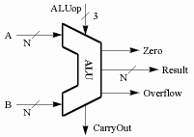
What is ALU?
An arithmetic-logic unit, or ALU, performs many different arithmetic and logic operations. The ALU is the “heart” of a processor—you could say that everything else in the CPU is there to support the ALU.
Two methods constitute the ALU
  extended the adder
  Parallel redundant select
Notes:
ALU是一种能进行多种算术运算与逻辑运算的组合逻辑电路，核心部件是带标志位加法器，多采用先行进位方式。
F：ALU flags，即OF、SF、ZF and CF
关于符号位，如溢出（OF）和进位（借位，CF）。

Slide 45
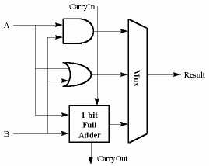
A Simple Example: 1-Bit ALU with 3 OPs
F_{1:0} | Function
00 | A & B
01 | A | B
10 | A + B
11 | not used
module ALU(
input [3:0] a, b,
input [1:0] aluop,
input cin,
output [3:0] f,
output OF, SF, ZF, CF,
output cout
);
wire [3:0] sum;
CLA_FLAGS(a, b, cin, sum, OF, SF, ZF, CF, cout);
always @(*) begin
case(aluop)
2’b00: f = a & b;
2’b01: f = a | b;
2’b10: f = sum;
default: f = 0;
endcase
end
endmodule
Notes:
The ALU is a combinational circuit that performs a set of basic arithmetic and logic microoperations. It has a number of selection lines used to determine the operation to be performed. The selection lines are decoded within the ALU, so that k selection lines can specify up to 2^{k} distinct operations.
default分支很重要，否则，综合器将会综合处锁存器，违反ALU组合逻辑电路的特性。
ALU中也可以实现左（右）移位操作，或者用专门的移位寄存器实现。多位（>2）的移位通常用ALU之外的桶形移位器实现，利用大量的多路选择器实现快速移位。

Slide 46
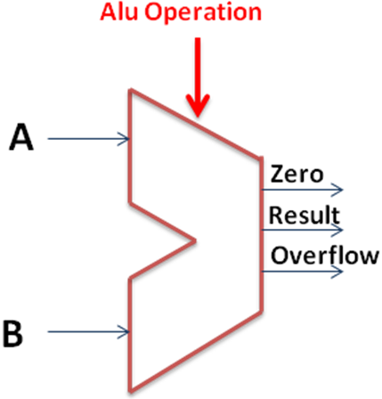
N-Bit ALU with 8 OPs
ALU Control Lines | Function
000 | And
001 | Or
010 | Add
110 | Sub
111 | SLT
100 | not
101 | srl
011 | xor
Notes:
SLT：Set Less Than, see next page

Slide 47
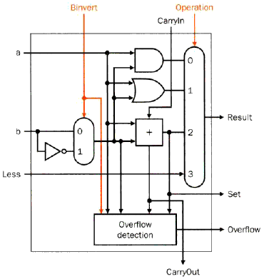
Set Less Than (SLT) Example
Configure 32-bit ALU for SLT operation: A = 25 and B = 32
  A < B, so Y should be 32-bit representation of 1 (0x00000001)
  slt rd,rs,rt
  If rs < rt, rd=1, else rd=0
  For rd, all bits = 0 except the least significant
  Subtraction (rs - rt), if the result is negative→ rs < rt
  Use of sign bit as indicator
Least
significant bit
Most
significant bit
Notes:
最高位0扩展

Slide 48
Set Less Than (SLT) Example
Configure 32-bit ALU for SLT operation: A = 25 and B = 32
  A < B, so Y should be 32-bit representation of 1 (0x00000001)
  F_{2:0} = 111
    F₂ = 1 (adder acts as subtracter), so 25 - 32 = -7
    -7 has 1 in the most significant bit (S₃₁ = 1)
    F_{1:0} = 11 multiplexer selects Y = S₃₁ (zero extended) = 0x00000001.
Notes:
最高位0扩展

Slide 49
Various Use of Shifters
Logical shifter: shifts value to left or right and fills empty spaces with 0’s
  11001 >> 2 = 00110
  11001 << 2 = 00100
Arithmetic shifter: same as logical shifter, but on right shift, fills empty spaces with the old most significant bit (MSB).
  11001 >>> 2 = 11110
  11001 <<< 2 = 00100
Rotator: rotates bits in a circle, such that bits shifted off one end are shifted into the other end
  11001 ROR 2 = 01110
  11001 ROL 2 = 00111

Slide 50
Shifters as Multipliers and Dividers
A << N = A × 2^{N}
  E.g., 00001 << 2 = 00100 (1 × 2² = 4)
  E.g., 11101 << 2 = 10100 (-3 × 2² = -12)
A >>> N = A ÷ 2^{N}
  E.g., 01000 >>> 2 = 00010 (8 ÷ 2² = 2)
  E.g., 10000 >>> 2 = 11100 (-16 ÷ 2² = -4)

Slide 51
Recall the Design of A Shifter
Bidirectional shift registers with parallel load
  Data from Bus B can be transferred to the register in parallel and then shifted to the right, the left, or not at all.
  A clock pulse loads the output of Bus B into the shift register, and a second clock pulse performs the shift.
  Finally, a third clock pulse transfers the data from the shift register to the selected destination register.
Alternatively, the transfer from a source register to a destination register can be done using only one clock pulse if the shifter is implemented as a combinational circuit
  Because of the faster operation that results from the use of one clock pulse instead of three, this is the preferred method.
  In a combinational shifter, the signals propagate through the gates without the need for a clock pulse.
  Hence, the only clock needed for a shift in the datapath is for loading the data from Bus H into the selected destination register.

Slide 52
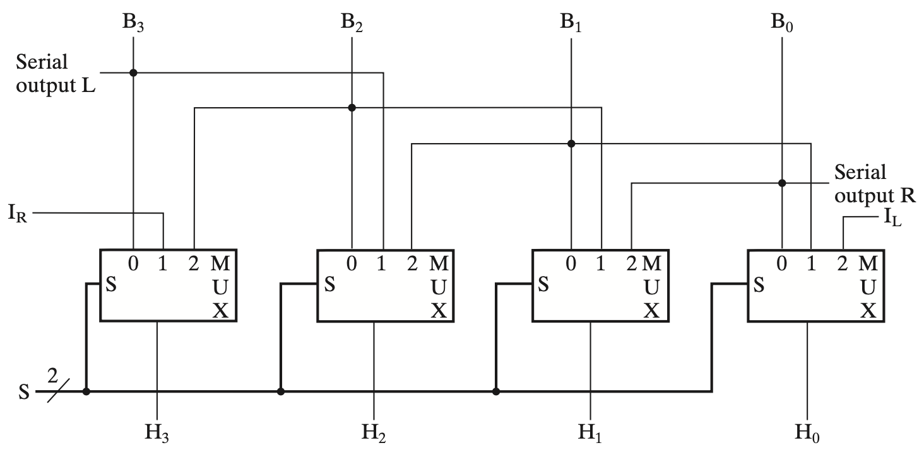
Shifter Design as A Combinational Circuit
Notes:
4-Bit Basic Shifter
0：load
1: 右移
2：左移

Slide 53
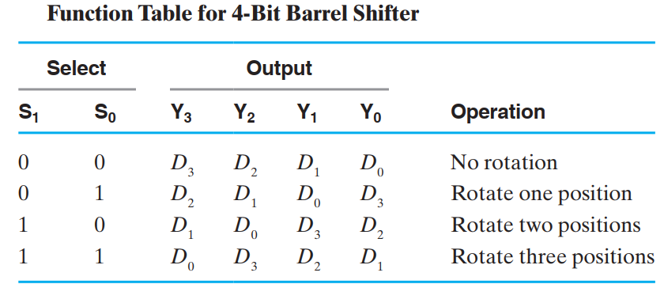
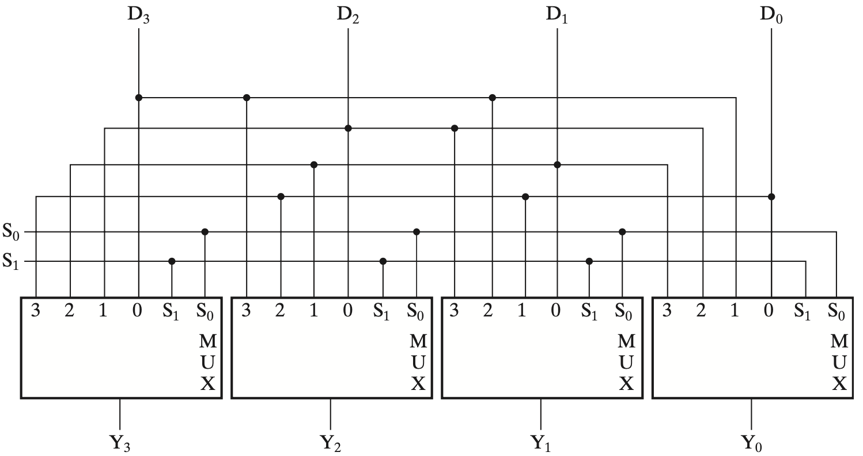
4-Bit Barrel Shifter (ROL)

Slide 54
Overview
Addition
Subtraction
Arithmetic logic unit (ALU)
Multiplication
Division
Floating number operations

Slide 55
Multiplication
More complicated than addition
  A straightforward implementation will involve shifts and adds
More complex operation can lead to
  More area (on silicon) and/or
  More time (multiple cycles or longer clock cycle time)
Let’s begin from a simple, straightforward method

Slide 56
Decimal vs. Binary Multiplication
Partial products formed by multiplying a single digit of the multiplier with multiplicand
Shifted partial products summed to form result

Slide 57
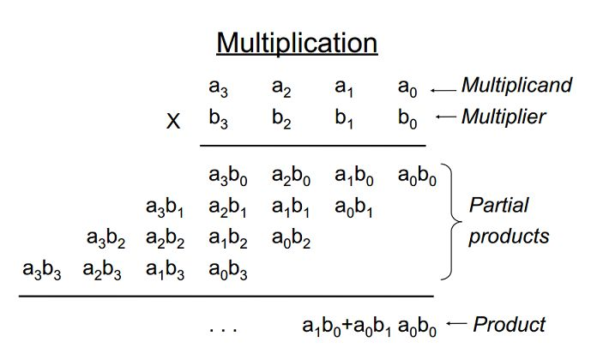
Unsigned Multiplication: 4-bit X 4-bit

Slide 58
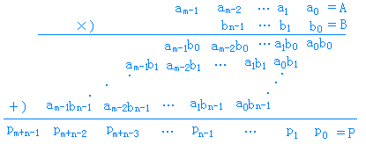
Unsigned Multiplication: M-bit X N-bit
A＝a_{m－1}…a₁a₀ B＝b_{n－1}…b₁b₀

Slide 59
Straightforward Algorithm
01010010 (multiplicand)
x
01101101 (multiplier)
01010010
00000000
01010010
01010010
00000000
01010010
01010010
00000000
010001011101010
Notes:
手算的特点：
用乘数的每一位依次乘以被乘数得到X x Y_{i}，如果Y_{i} = 0，则得到0；否则得到X；
把1中求得的各项结果逐次左移，而后求和。

Slide 60
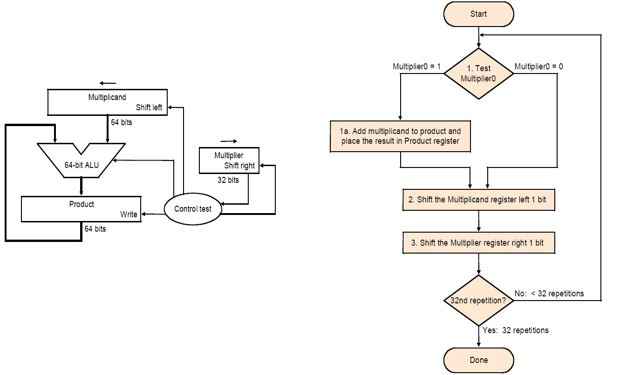
Implementation 1
Notes:
需要多个时钟周期完成，属于时序逻辑电路，由时钟信号控制。

Slide 61
Example of Implementation 1
Let’s do 0010 x 0110 (2 x 6), unsigned
Iteration | Implementation 1
 | Step | Multiplier | Multiplicand | Product
0 | initial values | 0110 | 0000 0010 | 0000 0000
1 | 1: 0 -> no op | 0110 | 0000 0010 | 0000 0000
 | 2: Multiplier shift right/ Multiplicand shift left | 011 | 0000 0100 | 0000 0000
2 | 1: 1 -> product = product + multiplicand | 011 | 0000 0100 | 0000 0100
 | 2: Multiplier shift right/ Multiplicand shift left | 01 | 0000 1000 | 0000 0100
3 | 1: 1 -> product = product + multiplicand | 01 | 0000 1000 | 0000 1100
 | 2: Multiplier shift right/ Multiplicand shift left | 0 | 0001 0000 | 0000 1100
4 | 1: 0 -> no op | 0 | 0001 0000 | 0000 1100
 | 2: Multiplier shift right/Multiplicand shift left |  | 0010 0000

Slide 62
Drawbacks
The ALU is twice as wide as necessary
The multiplicand register takes twice as many bits as needed
The product register won’t need 2n bits till the last step
  Being filled
The multiplier register is being emptied during the process

Slide 63
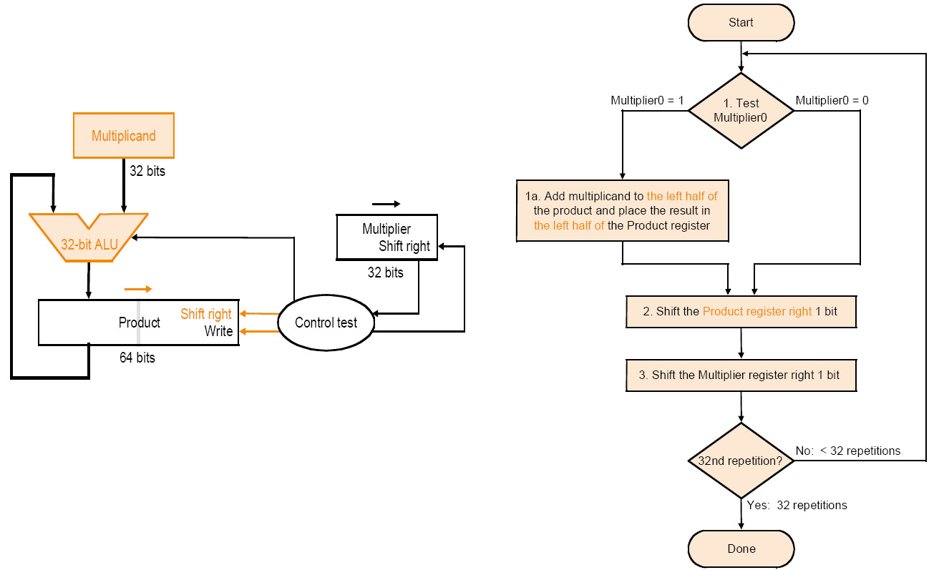
Implementation 2
Multiplicand stationary - Multiplier right - PP right
Notes:
计算机中为了提高效率，做了如下改进：
每次将乘数的一位乘以被乘数后（X x Y_{i}），将结果与前面所得累加，称为为部分积；
对乘数中为1的位执行加法和右移运算，对为0的位只执行右移运算，不需执行加法运算；
每次求得X x Y_{i}后，不是将它左移与前次部分积相加，而是将部分积右移一位与X x Y_{i}相加。

Slide 64
Example of Implementation 2
Let’s do 0010 x 0110 (2 x 6), unsigned
Iteration | Implementation 2
 | Step | Multiplier | Multiplicand | Product
0 | initial values | 0110 | 0010 | 0000 ××××
1 | 1: 0 -> no op | 0110 | 0010 | 0000 ××××
 | 2: Multiplier shift right/ Product shift right | ×011 | 0010 | 0000 0×××
2 | 1: 1 -> product = product + multiplicand | ×011 | 0010 | 0010 0×××
 | 2: Multiplier shift right/ Product shift right | ××01 | 0010 | 0001 00××
3 | 1: 1 -> product = product + multiplicand | ××01 | 0010 | 0011 00××
 | 2: Multiplier shift right/ Product shift right | _{×x×}0 | 0010 | 0001 100×
4 | 1: 0 -> no op | ×××0 | 0010 | 0001 100×
 | 2: Multiplier shift right/ Product shift right | ×××× | 0010 | 0000 1100

Slide 65
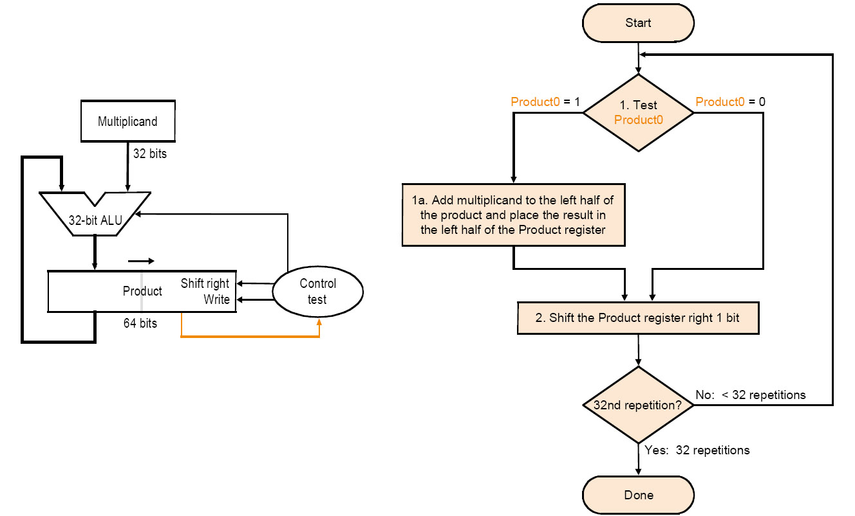
Implementation 3
Multiplier on right half of PP reg
Multiplicand stationary - Multiplier right - PP right

Slide 66
Example of Implementation 3
Let’s do 0010 x 0110 (2 x 6), unsigned
Iteration | Implementation 3
 | Step | Multiplier | Multiplicand | Product|Multiplier
0 | initial values | 0110 | 0010 | 0000 0110
1 | 1: 0 -> no op | 0110 | 0010 | 0000 0110
 | 2: Multiplier shift right/ Product shift right | ×011 | 0010 | 0000 0011
2 | 1: 1 -> product = product + multiplicand | ×011 | 0010 | 0010 0011
 | 2: Multiplier shift right/ Product shift right | ××01 | 0010 | 0001 0001
3 | 1: 1 -> product = product + multiplicand | ××01 | 0010 | 0011 0001
 | 2: Multiplier shift right/ Product shift right | ××00 | 0010 | 0001 1000
4 | 1: 0 -> no op | ×××0 | 0010 | 0001 1000
 | 2: Multiplier shift right/ Product shift right | ×××× | 0010 | 0000 1100

Slide 67
Signed Multiplication
Basic approach:
  Store the signs of the operands
  Convert signed numbers to unsigned numbers
  (most significant bit (MSB) = 0)
  Perform multiplication
  If sign bits of operands are equal
  sign bit = 0, else
  sign bit = 1
Improved method:
Booth's Algorithm
Assumption: addition and subtraction are available

Slide 68
Principle -- Decomposable multiplication
Assumes： Z=y×10111100
Z=y(10000000+111100+100-100)
=y(1×2⁷+1000000-100)
=y(1×2⁷+1×2⁶-2²)
=y(1×2⁷+1×2⁶+0×2⁵+0×2⁴+0×2³+0×2²+0×2¹+0×2⁰ -1×2² )
= y(1×2⁷+1×2⁶+0×2⁵+0×2⁴+0×2³+0×2²-1×2² +0×2¹+0×2⁰)
= y×2⁷+y×1×2⁶+0×2⁵+0×2⁴+0×2³ +0×2²-y×2² +0×2¹+0×2⁰)

Slide 69
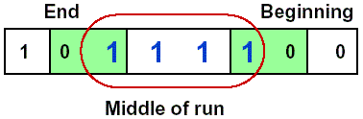
Booth's Algorithm
Idea: If you have a sequence of '1's
  subtract at first '1' in multiplier
  shift for the sequence of '1's
  add where prior step had last '1‘
Result:
  Possibly less additions and more shifts
  Faster, if shifts are faster than additions

Slide 70
Booth’s Algorithm
Current bit | Bit to right | Explanation | Example | Operation
1 | 0 | Begins run of ‘1’ | 00001111000 | Subtract
1 | 1 | Middle of run of ‘1’ | 00001111000 | Nothing
0 | 1 | End of a run of ‘1’ | 00001111000 | Add
0 | 0 | Middle of a run of ‘0’ | 00001111000 | Nothing

Slide 71
Example 1 of Booth’s Algorithm
Let’s do 0010 x 1101 (2 x -3)
Iteration | Implementation 3
 | Step | Multiplicand | Product
0 | initial values | 0010 | 0000 1101 0
1 | 10 -> product = product – multiplicand | 0010 | 1110 1101 0
 | shift right |  | 1111 0110 1
2 | 01 -> product = product + multiplicand | 0010 | 0001 0110 1
 | shift right |  | 0000 1011 0
3 | 10 -> product = product – multiplicand | 0010 | 1110 1011 0
 | shift right |  | 1111 0101 1
4 | 11 -> no op | 0010 | 1111 0101 1
 | shift right |  | 1111 1010 1

Slide 72
Example 2 of Booth’s Algorithm
Negative multiplicand:
  -6 x 6 = -36
  1010 x 0110, 0110 in Booth’s encoding is +0-0
  Hence:
1111 1010 | x 0 | 0000 0000
1111 0100 | x –1 | 0000 1100
1110 1000 | x 0 | 0000 0000
1101 0000 | x +1 | 1101 0000
 | Final Sum: | 1101 1100 (-36)

Slide 73
Example 3 of Booth’s Algorithm
Negative multiplier:
  -6 x -2 = 12
  1010 x 1110, 1110 in Booth’s encoding is 00-0
  Hence:
1111 1010 | x 0 | 0000 0000
1111 0100 | x –1 | 0000 1100
1110 1000 | x 0 | 0000 0000
1101 0000 | x 0 | 0000 0000
 | Final Sum: | 0000 1100 (12)

Slide 74
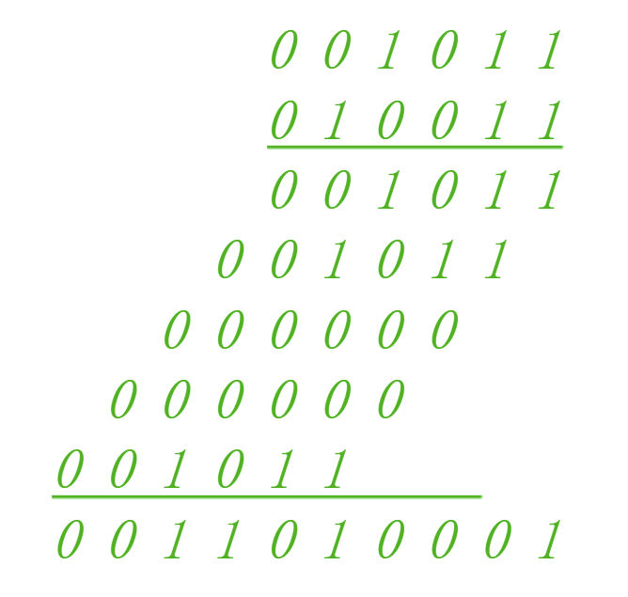
Summary
Benefit: Reducing the number of partial products
Take away: Booth encoding

Slide 75
Exercise
Unsigned Multiplication: x=5, y=3
Signed Multiplication: x=5, y=-7

Slide 76

Yet Another Option: Array Multiplier
 |  |  |  | 1 | 0 | 0 | 0
 |  |  | x | 1 | 0 | 0 | 1
 |  |  |  | 1 | 0 | 0 | 0
 |  |  | 0 | 0 | 0 | 0
 |  | 0 | 0 | 0 | 0
 | 1 | 0 | 0 | 0
 | 1 | 0 | 0 | 1 | 0 | 0 | 0
Adding all partial products simultaneously using an array of basic cells
Sin Cin Ai Bj
Ai ,Bj
Full Adder
Cout Sout
Notes:
采用硬件叠加或者流水处理的快速乘法器，如阵列乘法器，实现了手算的功能。

Slide 77
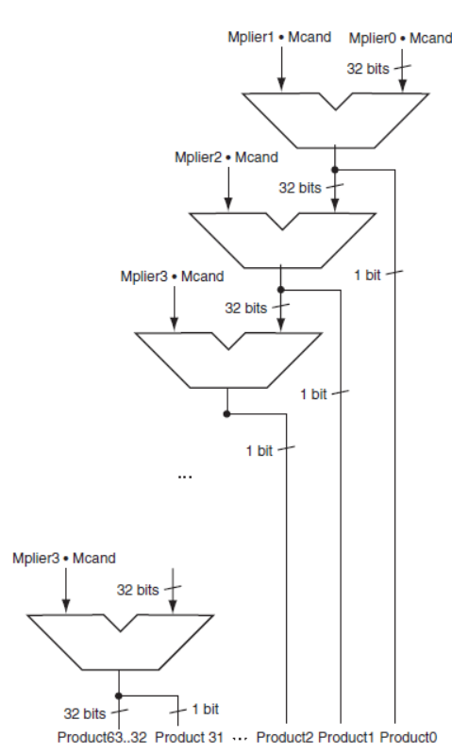
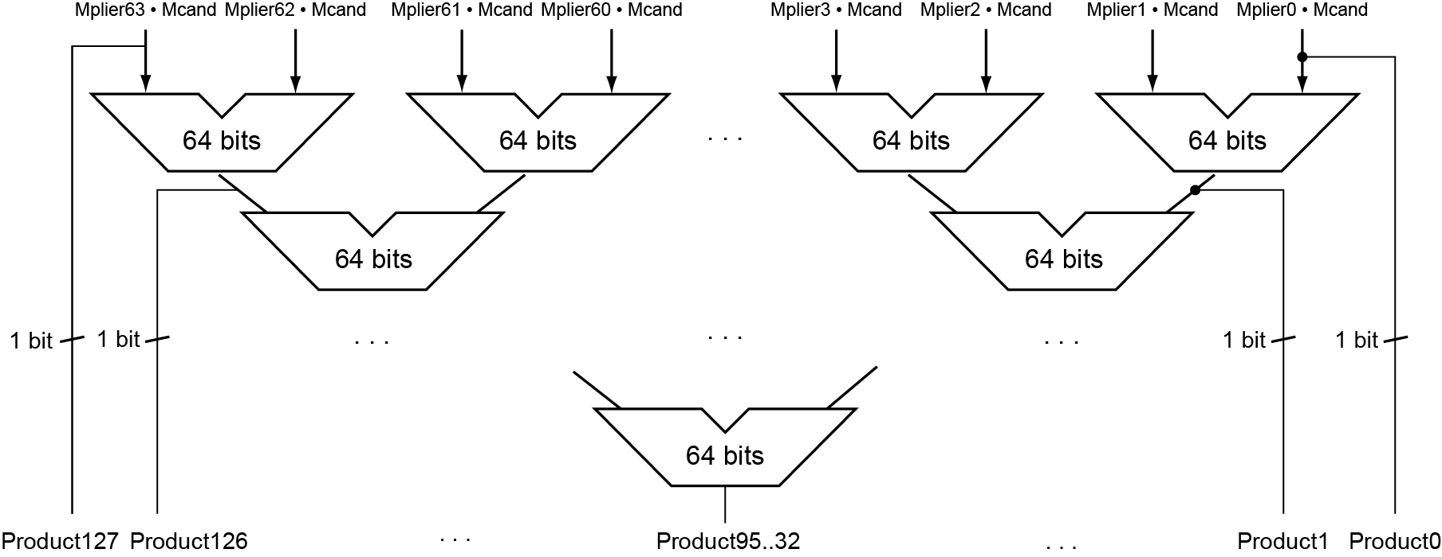
Faster Multiplication
Uses multiple adders
  Cost/performance tradeoff
Can be pipelined
  Several multiplication performed in parallel
Notes:
快速乘法可以通过为每个乘数位提供一个64位加法器来实现。可以以加法器栈的形式，也可以是如图所示的并行树。
最低位是积位，进位和高63位传给下一个加法器
延迟：log64=6次加法
事实上，由于使用进位保留加法器，乘法的速度甚至比6次加法还要快，并且容易流水化，能够支持多个乘法。
基于CRA，可优化：
1）CSA：carry save adder，进位保留加法器，本级进位与本级和同时输出至下一级, O(n)；
2）Wallace Tree：WT，华莱士树，适用于16位以上的乘法，O(log(n))

Slide 78
Overview
Addition
Subtraction
Arithmetic logic unit (ALU)
Multiplication
Division
Floating number operations

Slide 79
Unsigned Division
Again, back to 3rd grade (74 ÷ 8 = 9 rem 2)
 |  |  |  |  |  |  |  | 1 | 0 | 0 | 1 | Quotient
Divisor | 1 | 0 | 0 | 0 | 1 | 0 | 0 | 1 | 0 | 1 | 0 | Dividend
 |  |  |  | - | 1 | 0 | 0 | 0
 |  |  |  |  |  |  |  | 1 | 0
 |  |  |  |  |  |  |  | 1 | 0 | 1
 |  |  |  |  |  |  |  | 1 | 0 | 1 | 0
 |  |  |  |  |  |  | - | 1 | 0 | 0 | 0
 |  |  |  |  |  |  |  |  |  | 1 | 0 | Remainder
Notes:
Even more complicated
Can be accomplished via shifting and addition/subtraction
Negative numbers: Even more difficult
There are better techniques, we won’t look at them
类似部分积：中间余数
如果中间余数<除数，则中间余数不变
除数右移

Slide 80
Unsigned Division
How does hardware know if division fits?
  Condition: if remainder ≥ divisor
  Use subtraction: (remainder – divisor) ≥ 0
OK, so if it fits, what do we do?
  Remainder_{n+1} = Remainder_{n} – divisor
What if it doesn’t fit?
  Have to restore original remainder
Called restoring division
Notes:
restoring division:恢复余数除法

Slide 81
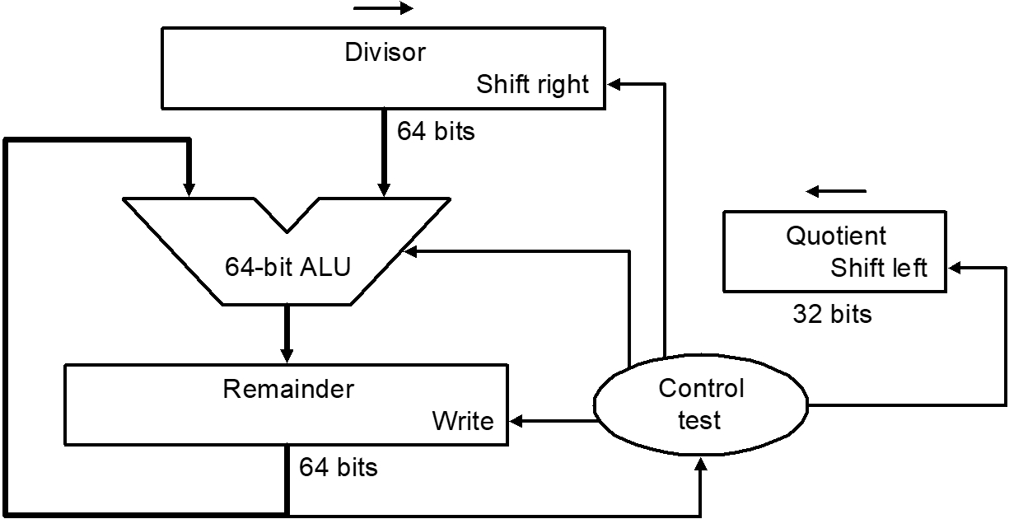
Implementation 1
 |  |  |  |  |  |  |  | 1 | 0 | 0 | 1 | Quotient
Divisor | 1 | 0 | 0 | 0 | 1 | 0 | 0 | 1 | 0 | 1 | 0 | Dividend
 |  |  |  | - | 1 | 0 | 0 | 0
 |  |  |  |  |  |  |  | 1 | 0
 |  |  |  |  |  |  |  | 1 | 0 | 1
 |  |  |  |  |  |  |  | 1 | 0 | 1 | 0
 |  |  |  |  |  |  | - | 1 | 0 | 0 | 0
 |  |  |  |  |  |  |  |  |  | 1 | 0 | Remainder
2. Do the division
1. Place dividend in lower half
3. Get remainder here

Slide 82
Implementation 1
 |  |  |  |  |  |  |  | 1 | 0 | 0 | 1 | Quotient
Divisor | 1 | 0 | 0 | 0 | 1 | 0 | 0 | 1 | 0 | 1 | 0 | Dividend
 |  |  |  | - | 1 | 0 | 0 | 0
 |  |  |  |  |  |  |  | 1 | 0
 |  |  |  |  |  |  |  | 1 | 0 | 1
 |  |  |  |  |  |  |  | 1 | 0 | 1 | 0
 |  |  |  |  |  |  | - | 1 | 0 | 0 | 0
 |  |  |  |  |  |  |  |  |  | 1 | 0 | Remainder

Slide 83
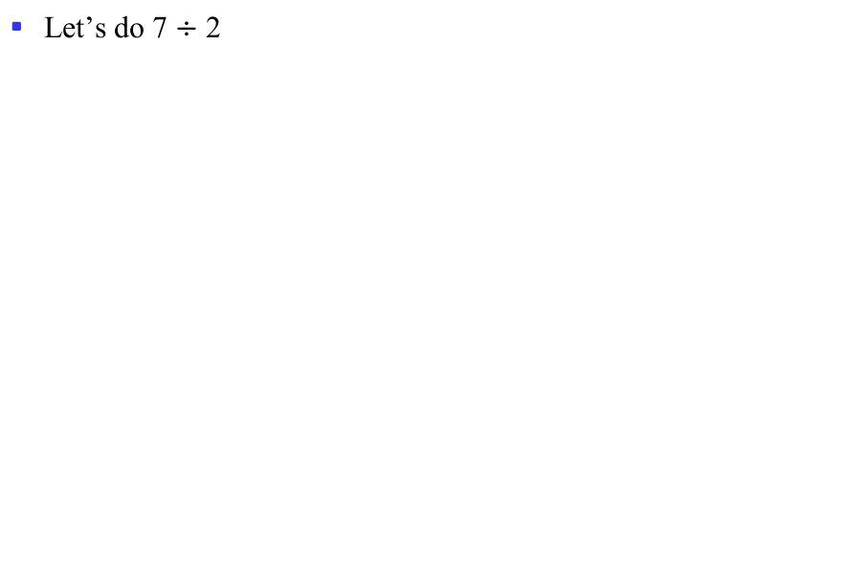
Example of Implementation 1
Let’s do 7 $÷$ 2
Iteration | Step | Quotient | Divisor | Remainder
0 | Initial values | 0000 | 0010 0000 | 0000 0111
1 | 1: Rem=Rem-Div | 0000 | 0010 0000 | 1110 0111
 | 2b: Rem<0=>+Div, sll Q, Q₀=0 | 0000 | 0010 0000 | 0000 0111
 | 3: Shift Div right | 0000 | 0001 0000 | 0000 0111
2 | 1: Rem=Rem-Div | 0000 | 0001 0000 | 1111 0111
 | 2b: Rem<0=>+Div, sll Q, Q₀=0 | 0000 | 0001 0000 | 0000 0111
 | 3: Shift Div right | 0000 | 0000 1000 | 0000 0111
3 | 1: Rem=Rem-Div | 0000 | 0000 1000 | 1111 1111
 | 2b: Rem<0=>+Div, sll Q, Q₀=0 | 0000 | 0000 1000 | 0000 0111
 | 3: Shift Div right | 0000 | 0000 0100 | 0000 0111
4 | 1: Rem=Rem-Div | 0000 | 0000 0100 | 0000 0011
 | 2a: Rem≥0=> sll Q, Q₀=1 | 0001 | 0000 0100 | 0000 0011
 | 3: Shift Div right | 0001 | 0000 0010 | 0000 0011
5 | 1: Rem=Rem-Div | 0001 | 0000 0010 | 0000 0001
 | 2a: Rem≥0=> sll Q, Q₀=1 | 0011 | 0000 0010 | 0000 0001
 | 3: Shift Div right | 0011 | 0000 0001 | 0000 0001

Slide 84
Division Improvements
Skip first subtract
  Can’t shift ‘1’ into quotient anyway
  Hence shift first, then subtract
    Undo extra shift at end
Hardware similar to multiplier
  Can store quotient in remainder register
  Only need 32-bit ALU
    Shift remainder left vs. divisor right

Slide 85
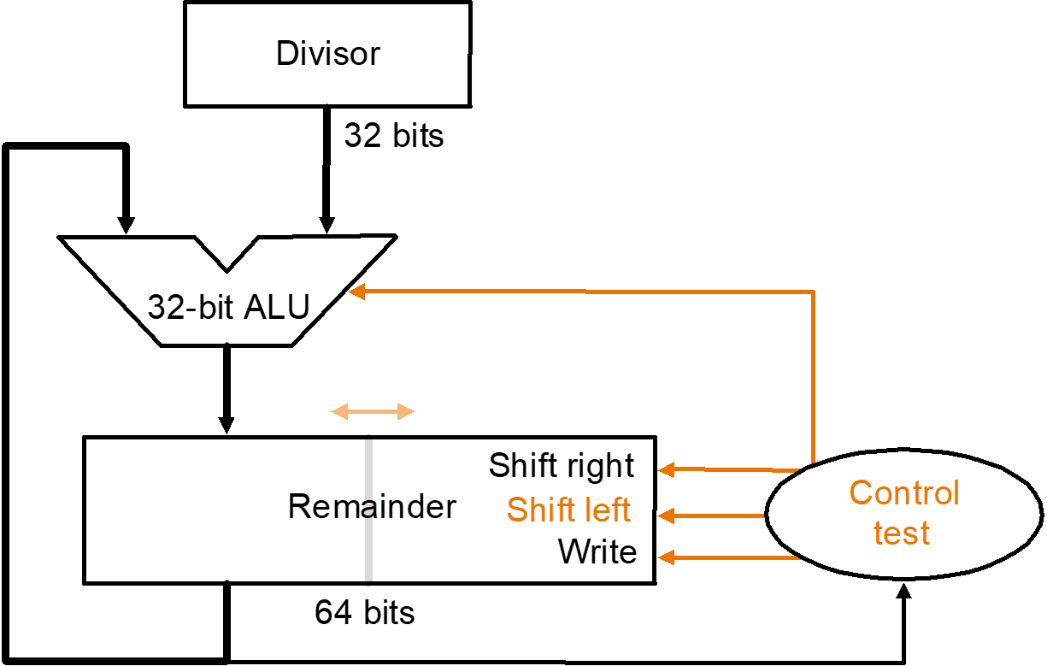
Implementation 2
2. Do the division
1. Place dividend in lower half
3. Get remainder here
4. Get quotient here

Slide 86
Implementation 2

Slide 87
Example 7/2 for Restoring Division
Well known numbers: 0000 0111/0010
iteration | step | Divisor | Remainder
0 | Initial Values | 0010 | 0000 0111
 | Shift Rem left 1 | 0010 | 0000 1110
1 | 1.Rem=Rem-Div | 0010 | 1110 1110
 | 2b: Rem<0 →+Div,sll R,R₀=0 | 0010 | 0001 1100
2 | 1.Rem=Rem-Div | 0010 | 1111 1100
 | 2b: Rem<0 →+Div,sll R,R₀=0 | 0010 | 0011 1000
3 | 1.Rem=Rem-Div | 0010 | 0001 1000
 | 2a: Rem>0 →sll R,R₀=1 | 0010 | 0011 0001
4 | 1.Rem=Rem-Div | 0010 | 0001 0001
 | 2a: Rem>0 →sll R,R₀=1 | 0010 | 0010 0011
 | Shift left half of Rem right 1 |  | 0001 0011

Slide 88
Further Improvements
Division still takes:
  2 ALU cycles per bit position
    1 to check for divisibility (subtract)
    One to restore (if needed)
Can reduce to 1 cycle per bit
  Called non-restoring division
  Avoids restore of remainder when test fails

Slide 89
Non-Restoring Division
Consider remainder to be restored:
  R_{i} = 2 x R_{i-1} – d < 0
  Since R_{i} is negative, we must restore it, right?
  Well, maybe not. Consider next step i+1:
  R_{i+1} = 2 x (R_{i}) – d = 2 x (R_{i} – d) + d
Hence, we can compute R_{i+1} by not restoring R_{i}, and adding d instead of subtracting d
  Same value for R_{i+1} results
Throughput of 1 bit per cycle

Slide 90
Non-Restoring Division
Iteration | Step | Divisor | Remainder
0 | Initial values | 0010 | 0000 0111
 | Shift rem left 1 | 0010 | 0000 1110
1 | 2: Rem = Rem - Div | 0010 | 1110 1110
 | 3b: Rem < 0 (add next), sll 0 | 0010 | 1101 1100
2 | 2: Rem = Rem + Div | 0010 | 1111 1100
 | 3b: Rem < 0 (add next), sll 0 | 0010 | 1111 1000
3 | 2: Rem = Rem + Div | 0010 | 0001 1000
 | 3a: Rem > 0 (sub next), sll 1 | 0010 | 0011 0001
4 | Rem = Rem – Div | 0010 | 0001 0001
 | Rem > 0 (sub next), sll 1 | 0010 | 0010 0011
 | Shift Rem right by 1 | 0010 | 0001 0011

Slide 91
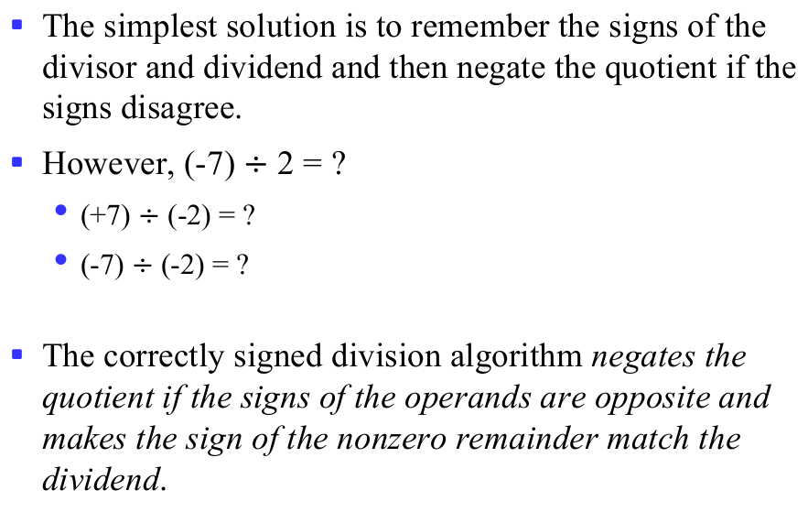
What About Signed Division?
The simplest solution is to remember the signs of the divisor and dividend and then negate the quotient if the signs disagree.
However, (-7) $÷$ 2 = ?
  (+7) $÷$ (-2) = ?
  (-7) $÷$ (-2) = ?
The correctly signed division algorithm negates the quotient if the signs of the operands are opposite and makes the sign of the nonzero remainder match the dividend.
Notes:
The absolute value of quotient!
(+7) $÷$ (-2) = -3 ...+1
(-7) $÷$ (-2) = +3 ...-1

Slide 92
Overview
Addition
Subtraction
Arithmetic logic unit (ALU)
Multiplication
Division
Floating number operations

Slide 93
Floating point addition
Example in decimal：system precision 4 digits
What is 9.999 • 10¹ + 1.610 • 10⁻¹ ?
Aligning the two numbers
9.999 •10¹
0.01610 •10¹ → 0.016 •10¹ Truncation
Addition
9.999 • 10¹
+ 0.016 • 10¹
10.015 • 10¹
Normalization
1.0015 • 10²
Rounding
1.002 • 10²
Notes:
Truncation=舍去

Slide 94
Floating point addition steps
Alignment
The proper digits have to be added
Addition of significands
Normalization of the result
Rounding
Notes:
表示的是离散的数，间隔也不是均匀的

Slide 95
Example y=0.5+(-0.4375) in binary
0.5₁₀ = 1.000₂×2⁻¹
-0.4375₂=-1.110₂×2⁻²
Step1:The fraction with lesser exponent is shifted right until matches
      -1.110₂×2⁻² → -0.111₂×2⁻¹
Step2: Add the significands
    1.000₂×2⁻¹
  +) - 0.111₂×2⁻¹
  0.001₂×2⁻¹
Step3: Normalize the sum and checking for overflow or underflow
    0.001₂×2⁻¹ → 0.010₂×2⁻² → 0.100₂×2⁻³ → 1.000₂×2⁻⁴
Step4: Round the sum
    1.000₂×2⁻⁴ = 0.0625₁₀

Slide 96
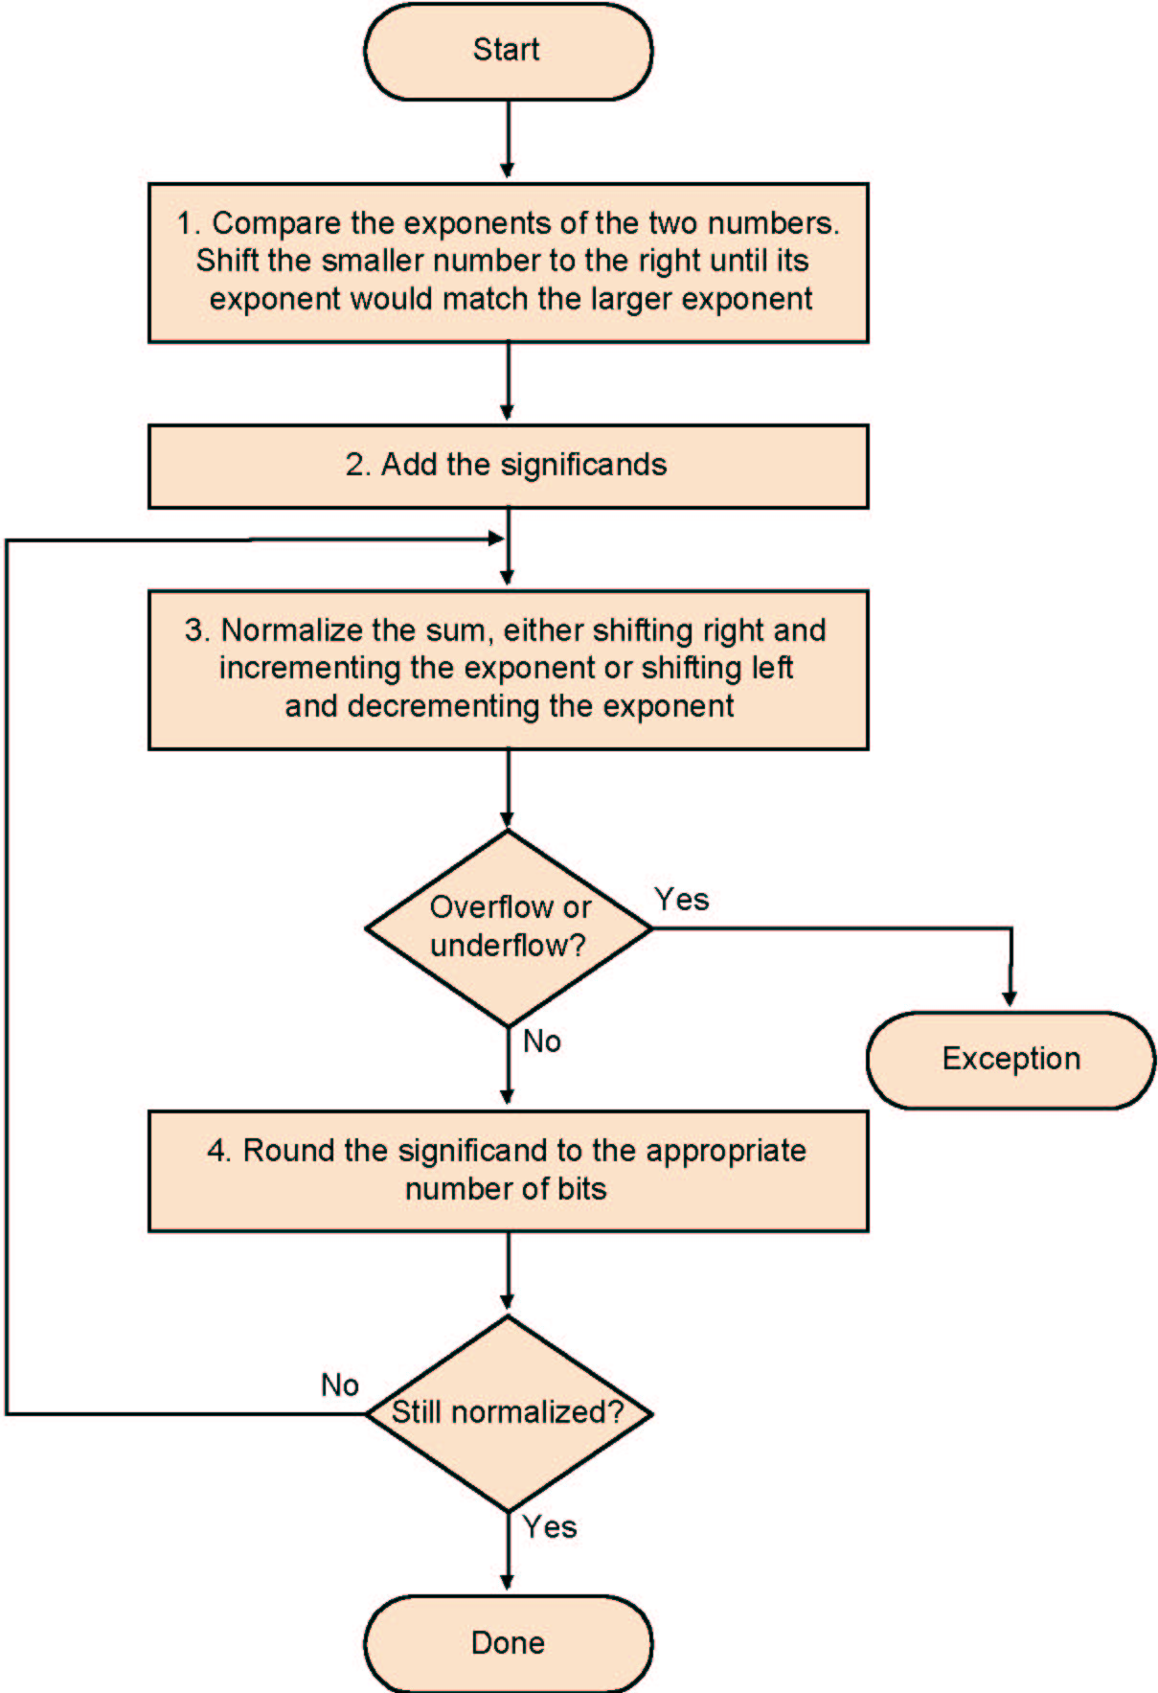
Algorithm
Normalize Significands
Add Significands
Normalize the sum
Over/underflow
Rounding
Normalization
Notes:
注意exponent的有效范围是1~254，就是127~(-126)

Slide 97
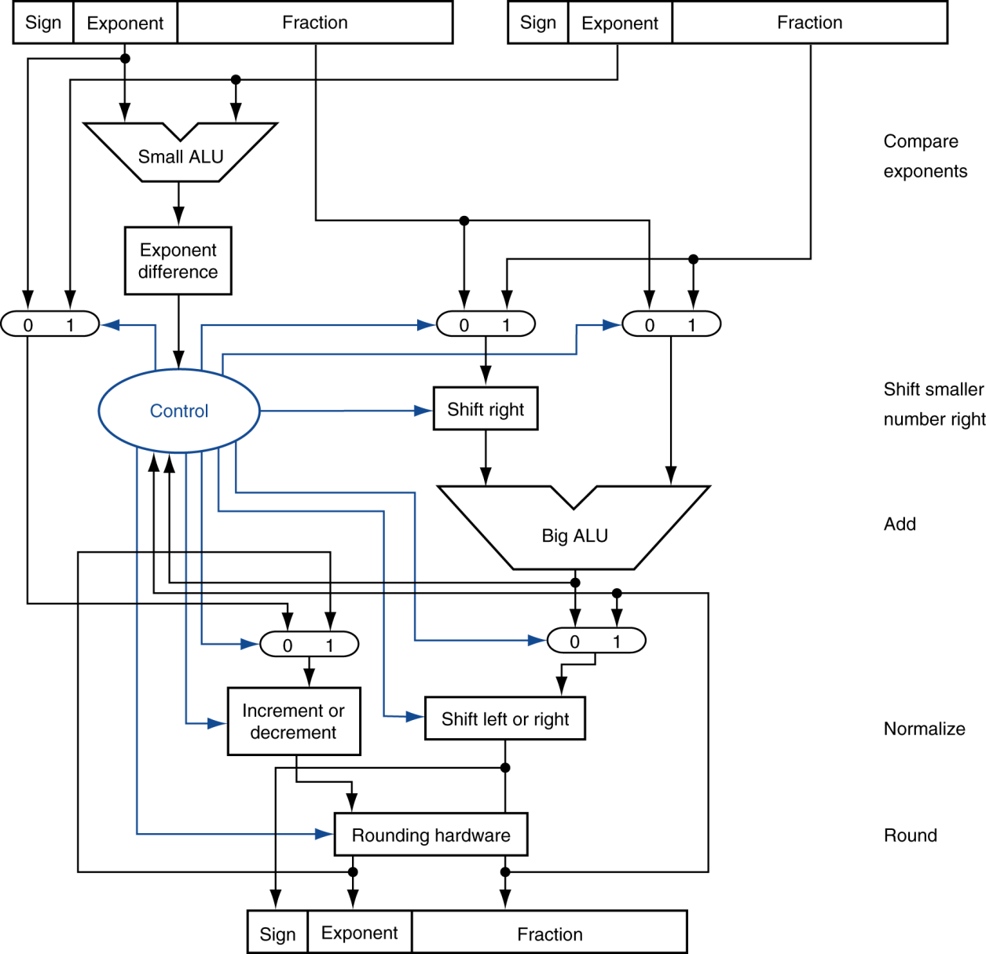
FP Adder Hardware
Step 1
Step 2
Step 3
Step 4
Notes:
移位之前要加上1
用软件写浮点数的运算

Slide 98
FP Adder Hardware
Much more complex than integer adder
Doing it in one clock cycle would take too long
  Much longer than integer operations
  Slower clock would penalize all instructions
FP adder usually takes several cycles
  Can be pipelined

Slide 99
Floating-Point Multiplication
Consider a 4-digit decimal example
  1.110 × 10¹⁰ × 9.200 × 10^{–5}
1. Add exponents
  For biased exponents, subtract bias from sum
  New exponent = 10 + –5 = 5
2. Multiply significands
  1.110 × 9.200 = 10.212 ⇒ 10.212 × 10⁵
3. Normalize result & check for over/underflow
  1.0212 × 10⁶
4. Round and renormalize if necessary
  1.021 × 10⁶
5. Determine sign of result from signs of operands
  +1.021 × 10⁶

Slide 100
Floating Point Multiplication
Composition of number from different parts
→ separate handling
(s1 • 2^{e1}) • (s2 • 2^{e2}) = (s1 • s2) • 2^{e1+ e2}
Example
1 10000010 000 0000 0000 0000 0000 0000 = -1 × 2³
0 10000011 000 0000 0000 0000 0000 0000 = 1 × 2⁴
Both significands are 1 → product = 1 →Sign=1
Add the exponents, bias = 127
        10000010
        +10000011
        110000101
Correction: 110000101-01111111=10000110=134=127+3+4
The result: 1 10000110 000 0000 0000 0000 0000 0000 = -1 × 2⁷

Slide 101
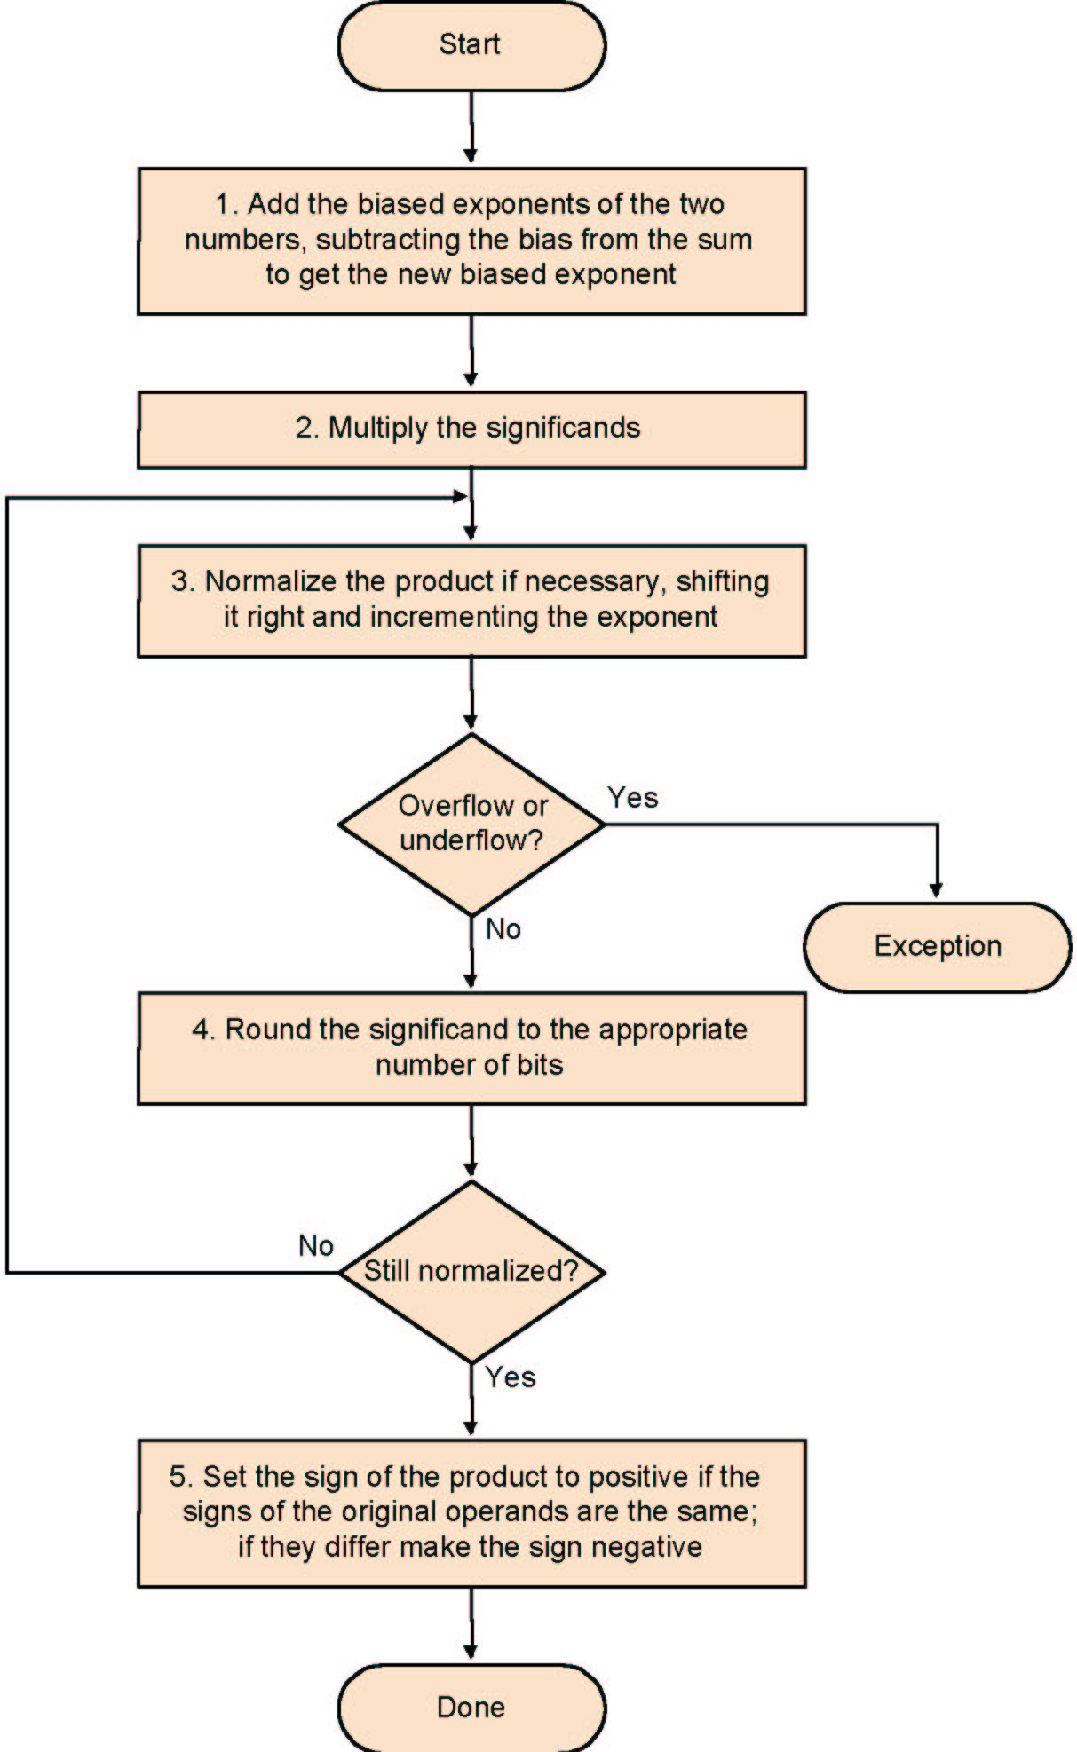
Multiplication
Add exponents
Multiply the significands
Normalize
Over- underflow
Rounding
Sign

Slide 102
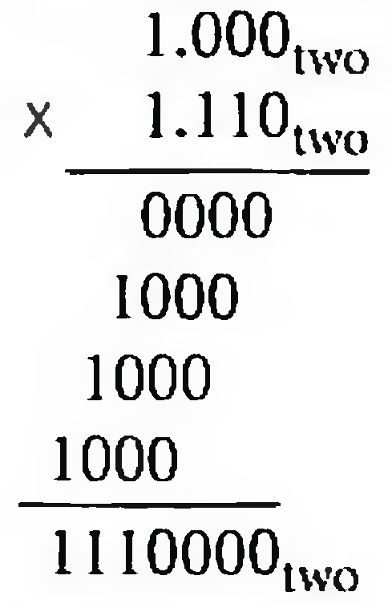
multiplying the numbers 0.5_{ten} and -0.4375_{ten}
→1.000_{two}x 2⁻¹ by -1.110_{two}x 2⁻²
Step1:Adding the exponents without bias or using the biased
  -1 + (-2)=-3
  (-1 + 127) + (-2 + 127) - 127 = (-1 - 2) + (127 + 127-127) =-3+127 = 124
Step 2. Multiplying the significands
  1.110000_{two}x2⁻³
Step 3. normalize
  127 ≥ -3 ≥ -126, no overflow or underflow.
Step 4. Rounding
  1.110_{two}x2⁻³
Step 5. sign
  -1.110_{two}x2⁻³ =-0.21875_{ten}

Slide 103
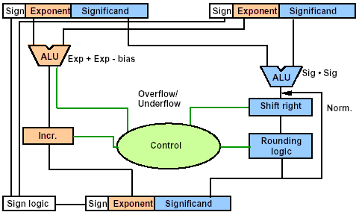
FP Multiplier Hardware

Slide 104
FP Arithmetic Hardware
FP multiplier is of similar complexity to FP adder
  But uses a multiplier for significands instead of an adder
FP arithmetic hardware usually does
  Addition, subtraction, multiplication, division, reciprocal, square-root
  FP ↔ integer conversion
Operations usually takes several cycles
  Can be pipelined

Slide 105
Division-- Brief
Subtraction of exponents
Division of the significands
Normalization
Rounding
Sign

Slide 106
END

Slide 107
Half Subtractor
Subtracting a single-bit binary value Y from anther X (i.e., X -Y ) produces a difference bit D and a borrow out bit B-out.
This operation is called half subtraction and the circuit to realize it is called a half subtractor.
Half Subtractor Truth Table
  D = X’Y + XY’
  = X ⊕ Y
  B-out = X’Y
Inputs
Outputs
X
0
0
1
1
Y
0
1
0
1
D
0
1
1
0
B-out
0
1
0
0
X
Y
Difference D
X
Half
Subtractor
D
Y
B-OUT
B-out
Notes:
HS vs. HA

Slide 108
Full Subtractor
Subtracting two single-bit binary values, Y, B-in from a single-bit value X produces a difference bit D and a borrow out B-out bit. This is called full subtraction.
Difference D
X
XY
Bin
00 01 11 10
0
1
0
2
1
6
4
1
Full Subtractor Truth Table
1
1
3
7
1
5
Bin
Inputs
Outputs
X
0
0
0
0
1
1
1
1
Y
0
0
1
1
0
0
1
1
B-in
0
1
0
1
0
1
0
1
D
0
1
1
0
1
0
0
1
B-out
0
1
1
1
0
0
0
1
Y
D = X’Y’(Bin) + XY’(Bin)’ + XY’(Bin)’ + XY(Bin)
D = X ⊕ Y ⊕ (Bin)
Borrow Bout
X
XY
Bin
00 01 11 10
0
1
0
2
1
6
4
1
1
3
1
7
1
5
Bin
  D(X,Y, Bin) = Σ (1,2,4,7)
  Bout(X, Y, Bin) = Σ (1,2,3,7)
Y
Bout = X’Y + X’(Bin) + Y(Bin)
Notes:
FS vs. FA
全加器进位
全减器借位

Slide 109
Full Subtractor Circuit Using AND-OR
X
X’
X’Y’Bin
Y’
X
X’
B-in
X’
X’YBin’
Difference D
Y
Y
Y
Y’
B-in’
X
Y
Bin
B-in’
XY’Bin’
Bin
Bin’
X
Y
XYBin
B-in’
X
Y
X’
X’Y
Full
Subtractor
Y
Bout
Bin
X’
X’Bin
Bout
B-in
Y
D
B-in
YBin

Slide 110
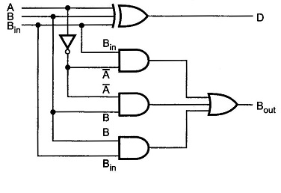
Circuit Using XOR

Slide 111
Implementation of N-bit Subtractors
An n-bit subtractor used to subtract an n-bit number Y from another n-bit number X (i.e., X-Y) can be built in one of two ways:
  By using n full subtractors and connecting them in series, creating a borrow ripple subtractor:
    Each borrow out B-out from a full subtractor at position j is connected to the borrow in B-in of the full subtractor at the higher position j+1.
  By using an n-bit adder and n inverters:
    Find 2’s complement of Y by:
      Inverting all the bits of Y using the n inverters.
      Adding 1 by setting the carry in of the least significant position to 1
    The original subtraction (X - Y) now becomes an addition of X to two’s complement of Y using the n-bit adder.
Notes:
2’s complement实现加减法统一

Slide 112
4-bit Borrow Ripple Subtractor
Subtracts two 4-bit numbers:
Y = Y3 Y2 Y1 Y0 from
X = X3 X2 X1 X0
  producing the difference D = D3 D2 D1 D0 , B_{out} = B4 from the most significant position j=3
Inputs
X3X2X1X0
Y3Y2Y1Y0
B4
4-bit
Subtractor
Bin
B0 =0
Bout
D3 D2 D1 D0
Difference Output D
Data inputs to be subtracted
X3
Y3
X2
Y2
X1
Y1
X0
Y0
B4
Full
Subtractor
B3
Full
Subtractor
B2
Full
Subtractor
B1
Full
Subtractor
B0 =0
Bout
Bin
Bout
Bin
Bout
Bin
Bout
Bin
D3
D2
D1
D0
Difference output D

Slide 113
4-bit Subtractor Using 4-bit Adder
Inputs to be subtracted
Y3 Y2 Y1 Y0
X3 X2 X1 X0
4-bit
Adder
C4
C-out
C-in
C0 = 1
S3 S2 S1 S0
D3 D2 D1 D0
Difference Output

Slide 114
32-bit CLA with 4-bit Blocks

Slide 115
Carry-Lookahead Adder Delay
t_{CLA} = t_{pg} + t_{pg_block} +(N/k - 1) t_{AND_OR} + kt_{FA}
t_{pg}: delay to generate all P_{i}G_{i}
t_{pg_block}: delay of generate all P_{i:j}, G_{i:j}
t_{AND_OR}: delay from C_{in} to C_{out} of final AND/OR gate in k-bit CLA block

Slide 116
Delay: RCA vs. CLA
Gate levels of C_{i} and S_{i}
  RCA (2 and 1) vs. CLA (3 and 4)
Different metric types
  Only gate levels
    All gates share the same cost
  With specs
    Delay of typical gate X # of gate levels
    E.g.,
      Carry propagation delay: 12 ns
      Sum propagation delay: 15 ns
An N-bit carry-lookahead adder is generally much faster than a ripple-carry adder for N > 16

Slide 117
Datapath and ALU
The datapath and the control unit are the two parts of the processor, or CPU, of a computer.
Instead of having each individual register perform its microoperations directly, computer systems often employ many storage registers in conjunction with a shared operation unit called an arithmetic/logic unit, abbreviated ALU.
  To perform a microoperation, the contents of specified source registers are applied to the inputs of the shared ALU. The ALU performs an operation, and the result of this operation is transferred to a destination register.

Slide 118
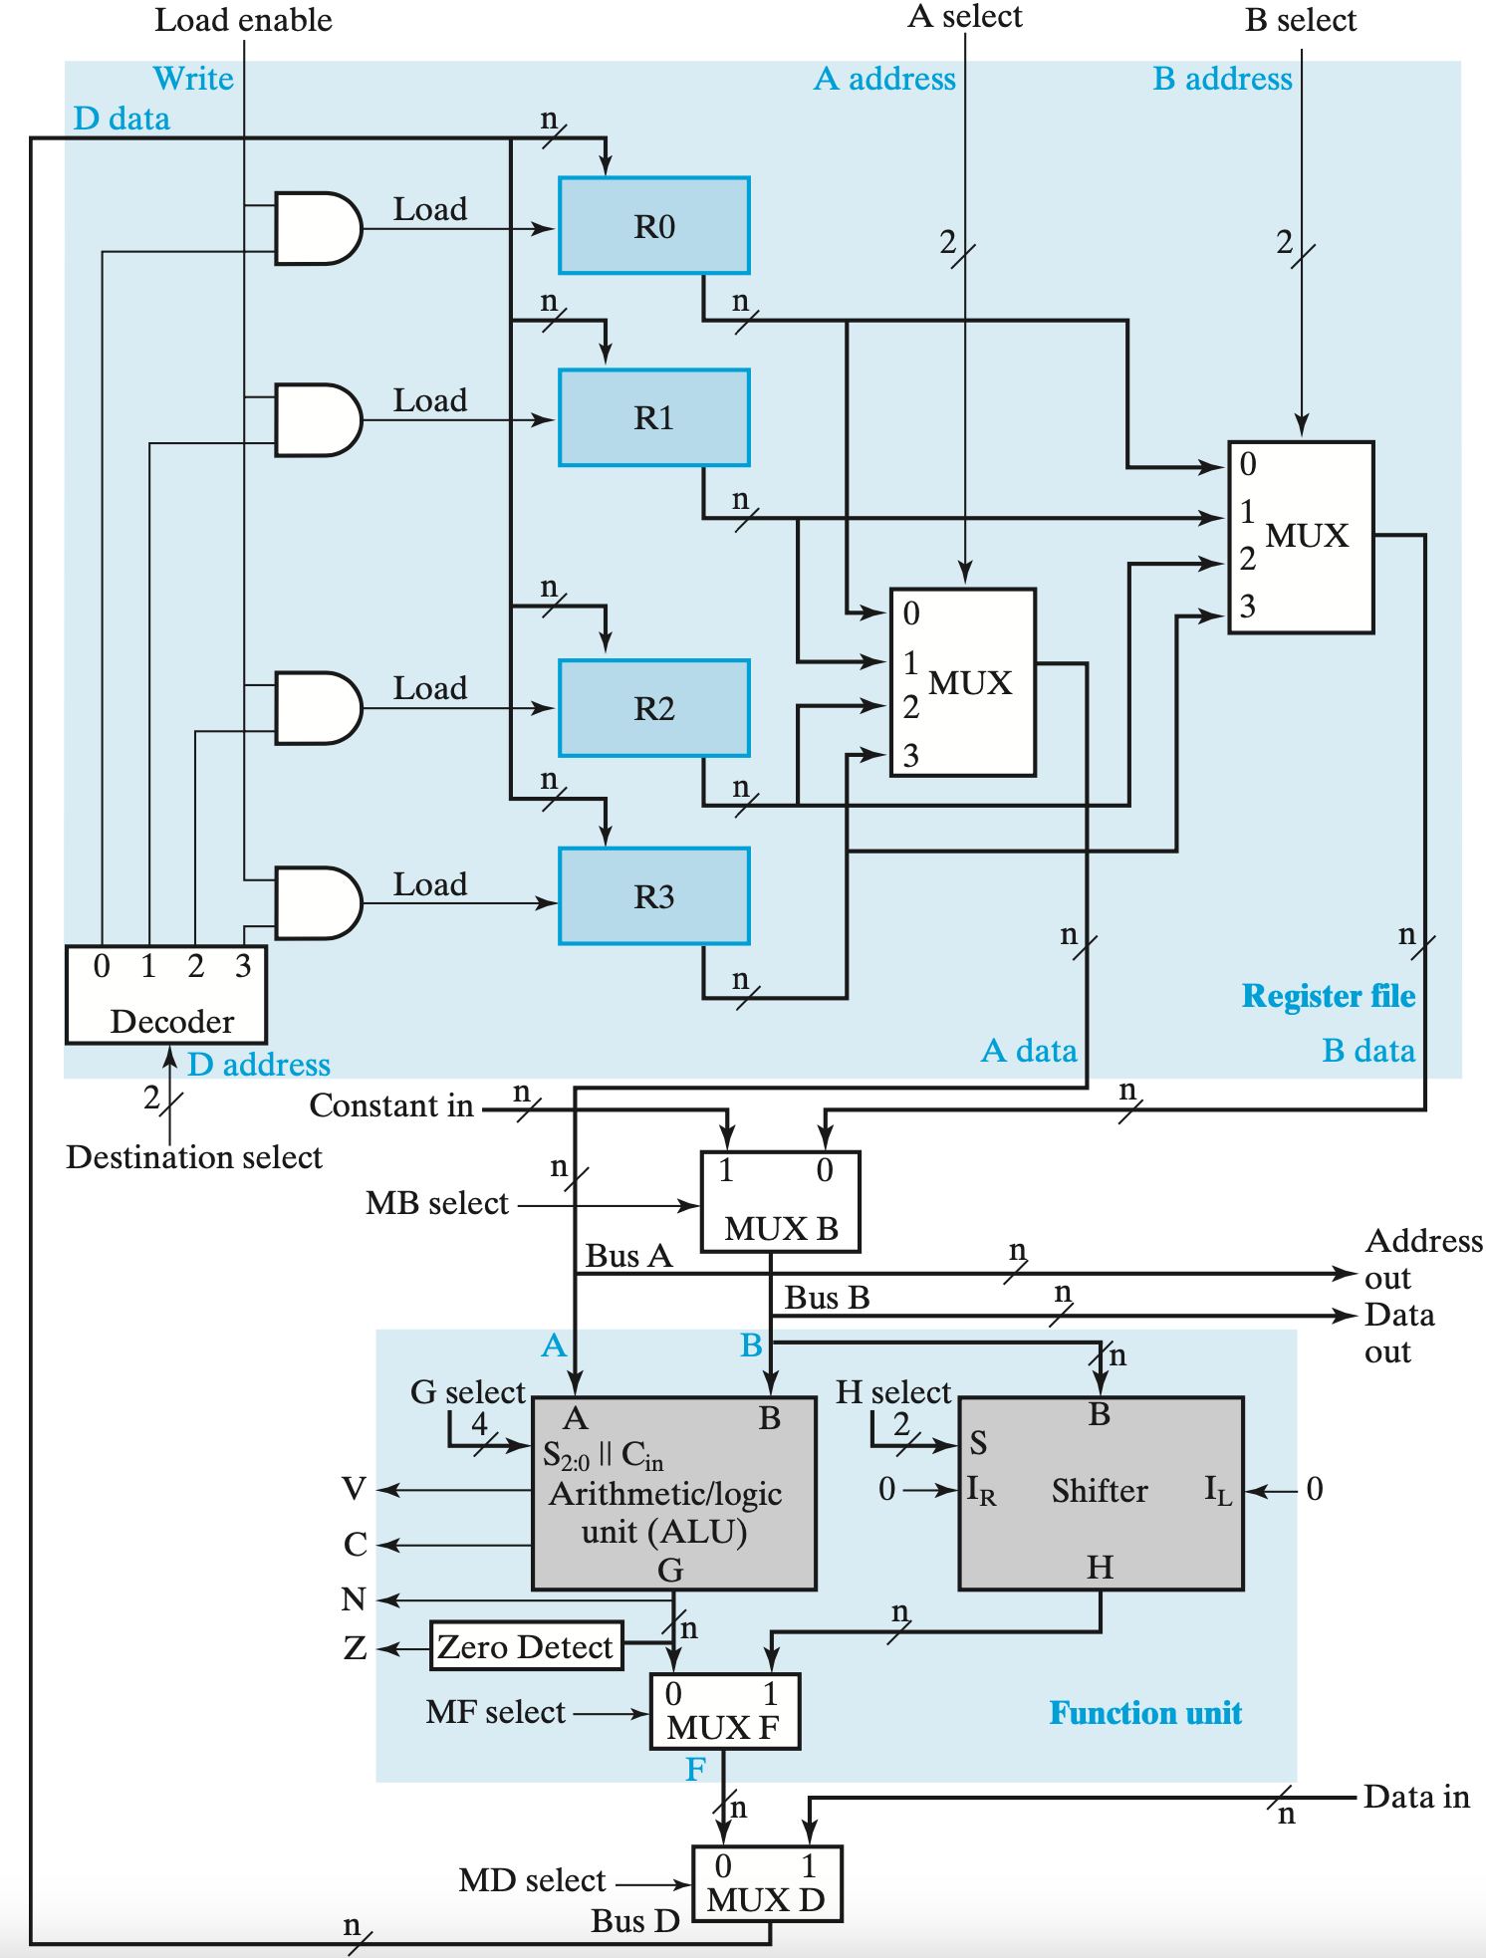
Datapath = ALU + Registers
The combination of a set of registers with a shared ALU and interconnecting paths is the datapath for the system.
The control unit for the datapath directs the information low through the buses, the ALU, the shifter, and the registers by applying signals to the select inputs.
Notes:
Each register is connected to two multiplexers to form ALU and shifter input buses A and B. The select inputs on each multiplexer select one register for the corresponding bus. For Bus B, there is an additional multiplexer, MUX B, so that constants can be brought into the datapath from outside using Constant in. Bus B also connects to Data out, to send data outside the datapath to other components of the system, such as memory or input–output. Likewise, Bus A connects to Address out, to send address information outside of the datapath for memory or input–output.
The sets of values must be generated and must become available on the corresponding control lines early in the clock cycle. The binary data from the two source registers must propagate through the multiplexers and the ALU and on into the inputs of the destination register, all during the remainder of the same clock cycle. Then, when the next positive clock edge arrives, the binary data on Bus D is loaded into the destination register. To achieve fast operation, the ALU and shifter are con- structed with combinational logic having a limited number of levels.

Slide 119
ALU in the Datapath
With the ALU as a combinational circuit, the entire register transfer operation from the source registers, through the ALU, and into the destination register is performed during one clock cycle.
  The shift operations are often performed in a separate unit, but sometimes these operations are also implemented within the ALU.
Notes:
Arithmetic and logic microoperations are performed on the operands on the A and B buses by the ALU. The G select inputs select the microoperation to be per- formed by the ALU. The shift microoperations are performed on data on Bus B by the shifter. The H select input either passes the operand on Bus B directly through to the shifter output or selects a shift microoperation. MUX F selects the output of the ALU or the output of the shifter. MUX D selects the output of MUX F or external data on input Data in to be applied to Bus D. The latter is connected to the inputs of all the registers. The destination select inputs determine which register is loaded with the data on Bus D. Since the select inputs are decoded, only one register Load signal is active for any transfer of data into a register from Bus D. A Load enable signal that can force all register Load signals to 0 using AND gates is present for transfers that are not to change the contents of any of the four registers.

Slide 120
How to Revise it?
01010010 (multiplicand)
x
01101101 (multiplier)
000000000000000 (partial sum)
Notes:
为了效率考虑，可以做如下改进：
每次将乘数的一位乘以被乘数后（X x Y_{i}），将结果与前面所得累加，称为为部分积；
对乘数中为1的位执行加法和右移运算，对为0的位只执行右移运算，不需执行加法运算。

Slide 121
How to Revise it?
01010010 (multiplicand)
x
01101101 (multiplier)
000000001010010 (partial sum)

Slide 122
How to Revise it?
01010010 (multiplicand)
x
01101101 (multiplier)
000000001010010 (partial sum)
00000000

Slide 123
How to Revise it?
01010010 (multiplicand)
x
01101101 (multiplier)
000000001010010 (partial sum)

Slide 124
How to Revise it?
01010010 (multiplicand)
x
01101101 (multiplier)
000000001010010 (partial sum)
01010010

Slide 125
How to Revise it?
01010010 (multiplicand)
x
01101101 (multiplier)
000000110011010 (partial sum)

Slide 126
How to Revise it?
01010010 (multiplicand)
x
01101101 (multiplier)
000000110011010 (partial sum)
01010010

Slide 127
How to Revise it?
01010010 (multiplicand)
x
01101101 (multiplier)
000010000101010 (partial sum)

Slide 128
How to Revise it?
01010010 (multiplicand)
x
01101101 (multiplier)
000010000101010 (partial sum)
00000000

Slide 129
How to Revise it?
01010010 (multiplicand)
x
01101101 (multiplier)
000010000101010 (partial sum)

Slide 130
How to Revise it?
01010010 (multiplicand)
x
01101101 (multiplier)
000010000101010 (partial sum)
01010010

Slide 131
How to Revise it?
01010010 (multiplicand)
x
01101101 (multiplier)
000111001101010 (partial sum)

Slide 132
How to Revise it?
01010010 (multiplicand)
x
01101101 (multiplier)
000111001101010 (partial sum)
01010010

Slide 133
How to Revise it?
01010010 (multiplicand)
x
01101101 (multiplier)
010001011101010 (partial sum)

Slide 134
How to Revise it?
01010010 (multiplicand)
x
01101101 (multiplier)
010001011101010 (partial sum)
00000000

Slide 135
How to Revise it?
01010010 (multiplicand)
x
01101101 (multiplier)
010001011101010 (full sum)

Slide 136
Example of Signed Multiplication
Note:
  Sign extension of partial product
  If most significant bit of multiplier is 1, then subtract
+
+
+
+
→
→
→
→
+
→
→
+
→
→
→
→
+
+
→
→
→
→
→
→

Slide 137
Booth’s Encoding
Really just a new way to encode numbers
  Normally positionally weighted as 2^{n}
  With Booth, each position has a sign bit
  Can be extended to multiple bits
Y_{j} | Y_{j-1} | 1-bit Encoding
0 | 0 | +0
0 | 1 | +1
1 | 0 | -1
1 | 1 | -0
Y_{j+1} | Y_{j} | Y_{j-1} | 2-bit Encoding
0 | 0 | 0 | +0
0 | 0 | 1 | +1
0 | 1 | 0 | +1
0 | 1 | 1 | +2
1 | 0 | 0 | -2
1 | 0 | 1 | -1
1 | 1 | 0 | -1
1 | 1 | 1 | -0
0 | 1 | 1 | 0 | Binary
+1 | 0 | -1 | 0 | 1-bit Booth
+2 |  | -2 |  | 2-bit Booth

Slide 138
2-bits/cycle Booth Multiplier
For every pair of multiplier bits
  If Booth’s encoding is ‘-2’
    Shift multiplicand left by 1, then subtract
  If Booth’s encoding is ‘-1’
    Subtract
  If Booth’s encoding is ‘0’
    Do nothing
  If Booth’s encoding is ‘1’
    Add
  If Booth’s encoding is ‘2’
    Shift multiplicand left by 1, then add

Slide 139
2 bits/cycle Booth’s
1 bit Booth
00 | +0
01 | +M;
10 | -M;
11 | +0
Current | Previous | Operation | Explanation
00 | 0 | +0;shift 2 | [00] => +0, [00] => +0; 2x(+0)+(+0)=+0
00 | 1 | +M; shift 2 | [00] => +0, [01] => +M; 2x(+0)+(+M)=+M
01 | 0 | +M; shift 2 | [01] => +M, [10] => -M; 2x(+M)+(-M)=+M
01 | 1 | +2M; shift 2 | [01] => +M, [11] => +0; 2x(+M)+(+0)=+2M
10 | 0 | -2M; shift 2 | [10] => -M, [00] => +0; 2x(-M)+(+0)=-2M
10 | 1 | -M; shift 2 | [10] => -M, [01] => +M; 2x(-M)+(+M)=-M
11 | 0 | -M; shift 2 | [11] => +0, [10] => -M; 2x(+0)+(-M)=-M
11 | 1 | +0; shift 2 | [11] => +0, [11] => +0; 2x(+0)+(+0)=+0

Slide 140
Why It Works?
Booth's algorithm performs an addition when it encounters the first digit of a block of ones (0 1) and a subtraction when it encounters the end of the block (1 0).
When the ones in a multiplier are grouped into long blocks, Booth's algorithm performs fewer additions and subtractions than the normal multiplication algorithm.
b × (a₃₁a₃₀….a₀)
= a₀ × b × 2⁰ +
a₁ × b × 2¹ +
…
a₃₁ × b × 2³¹
= ( 0 – a₀ ) × b × 2⁰ +
( a₀ – a₁) × b × 2¹ +
…
(a₃₀ – a₃₁) × b × 2³¹ +
a₃₁ × b × 2³²
Notes:
a: multiplier
b: multiplicand

Slide 141
Why It Works?
Works for positive multiplier coz a₃₁ is 0
What happens for negative multipliers? a₃₁ is 1
  Remember that we are using 2’s complement binary
b × (a₃₁a₃₀….a₀) = b × (- a₃₁ × 2³¹+a₃₀ × 2³⁰+….a₀ ×2⁰)
Same derivation applies

Slide 142
4 x 4 Divider
A/B = Q + R/B
Algorithm:
R’ = 0
for i = N-1 to 0
R = {R’ << 1. Ai}
D = R - B
if D < 0, Qi=0, R’=R
else Qi=1, R’=D
R’=Rc

Slide 143
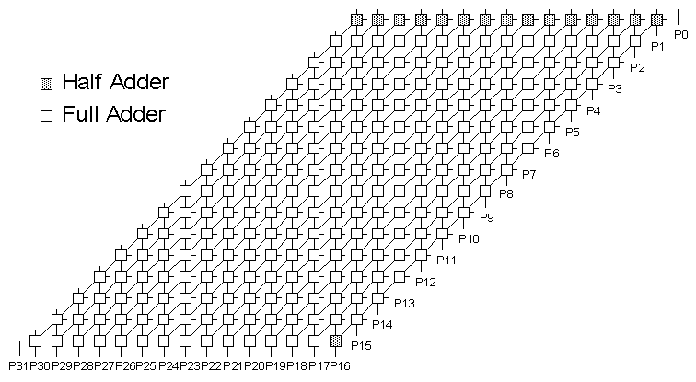
16-bit Array Multiplier
Conceptually straightforward
Fairly expensive hardware, integer multiplies relatively rare
  Most used in array address calc: replace with shifts
Notes:
基于CRA，可优化：
1）CSA：carry save adder，进位保留加法器，本级进位与本级和同时输出至下一级, O(n)；
2）Wallace Tree：WT，华莱士树，适用于16位以上的乘法，O(log(n))

